Slide 1
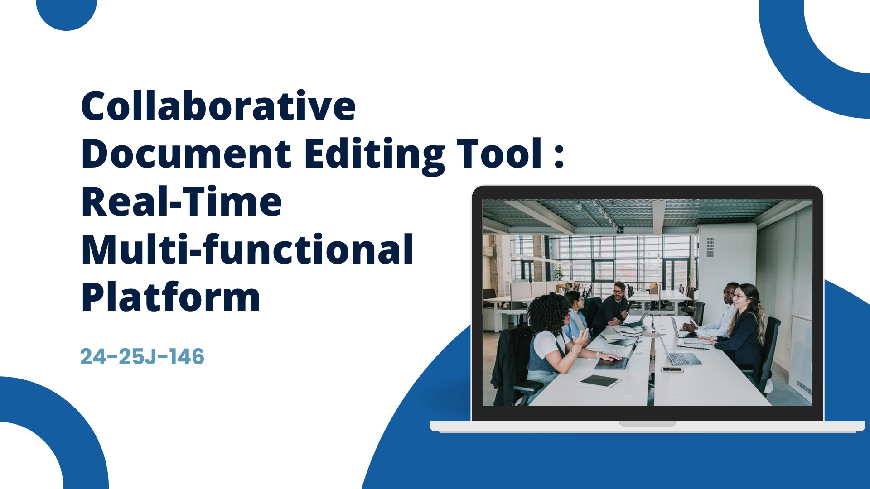
19/03/2025
Notes:
Good afternoon everyone we are from RP -24-25 J 146 we bring forward to you an application which is a collaborative document editing tool named as Write Wizard

Slide 2
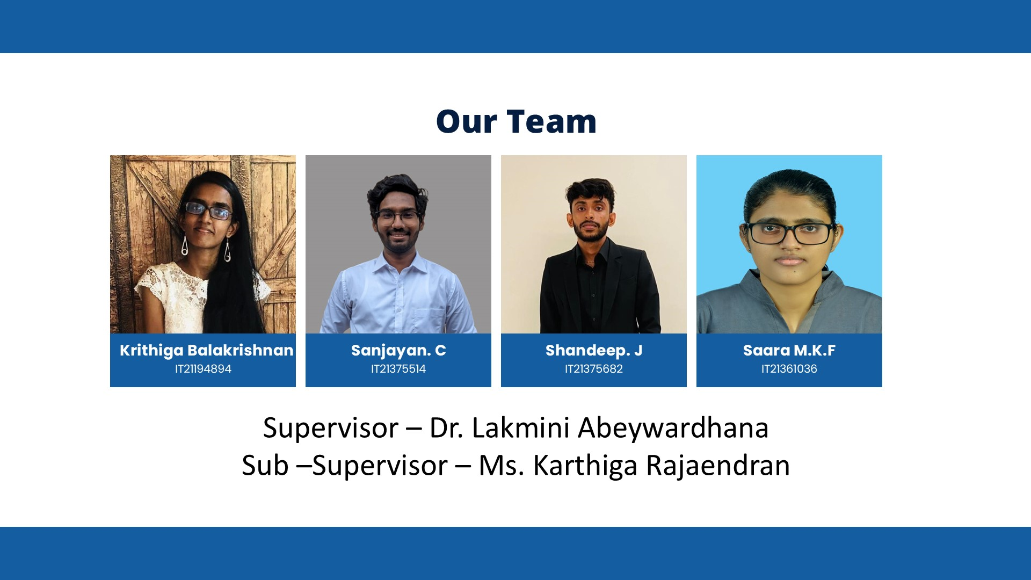
19/03/2025

Slide 3
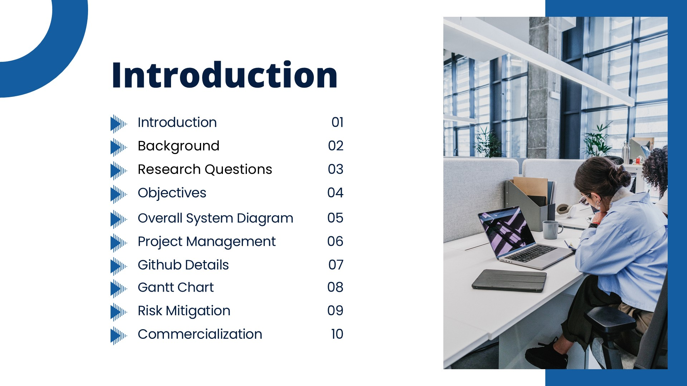
19/03/2025

Slide 4
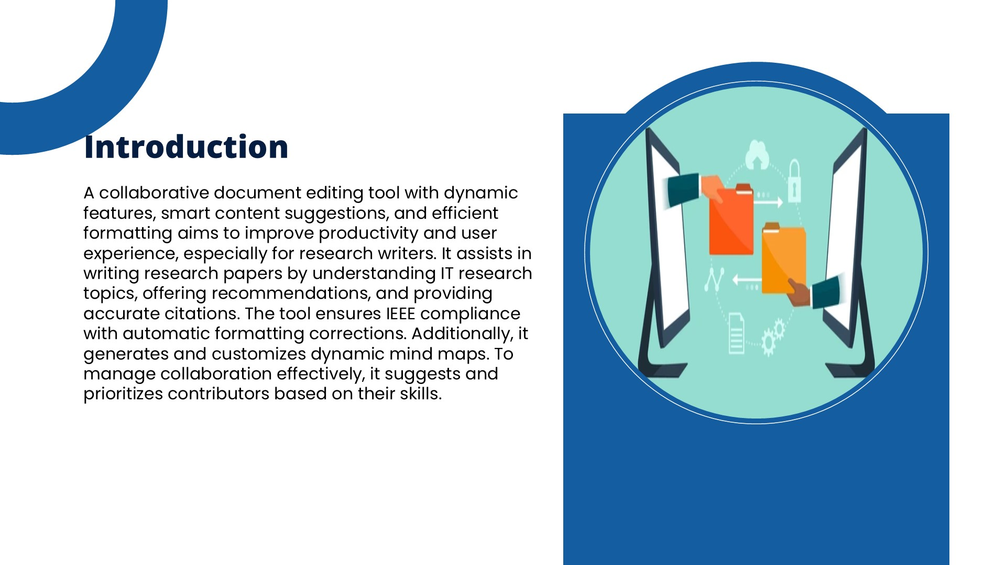
19/03/2025
Notes:
This tool has dynamic features, smart content suggestions and excellent formatting to improve the productivity of the writing especially for research authors. it assists by providing academic formating to your writing in IEEE compliance, provides references and accurate citation. Additionally it provides a user customizable mind-map to better understand your content. As it is a collaborative tool and there can be multiple research authors the tool also suggests which author is the best author to contribute which part in the research paper.

Slide 5
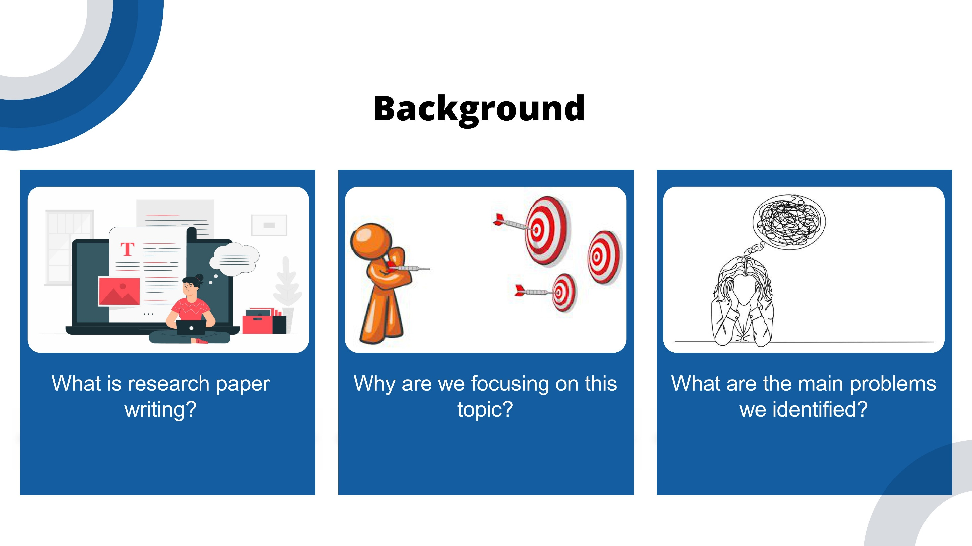
19/03/2025
Notes:
We took this research and project into consideration due to lack of tools we find in to pimprove the research writing for authors, the main problems we understood will be discussed further by each of us.

Slide 6
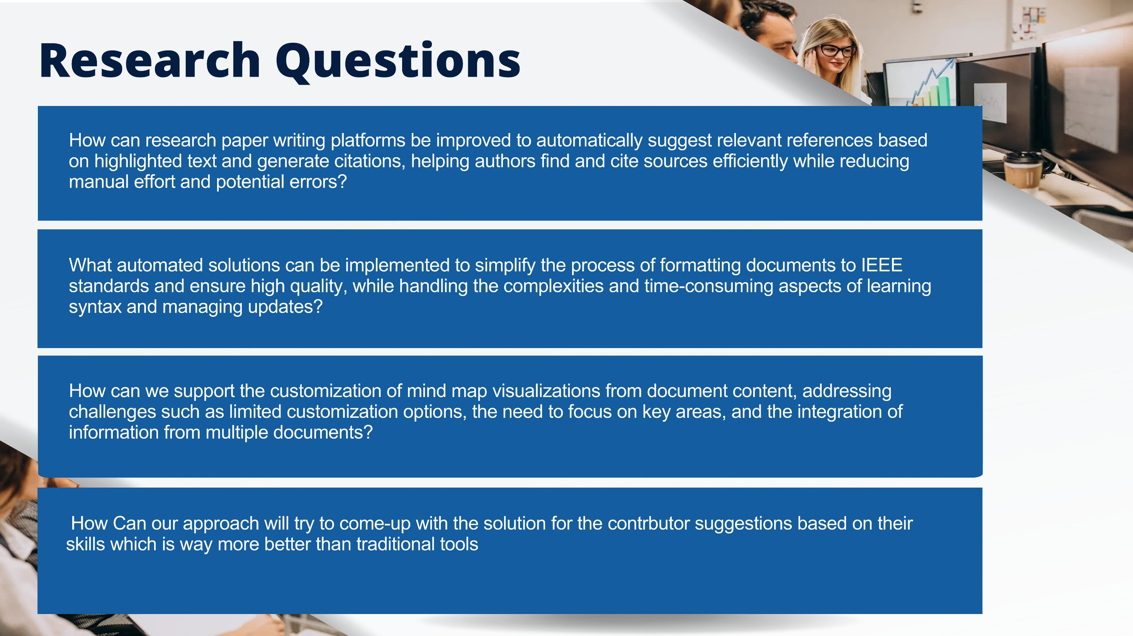
19/03/2025

Slide 7
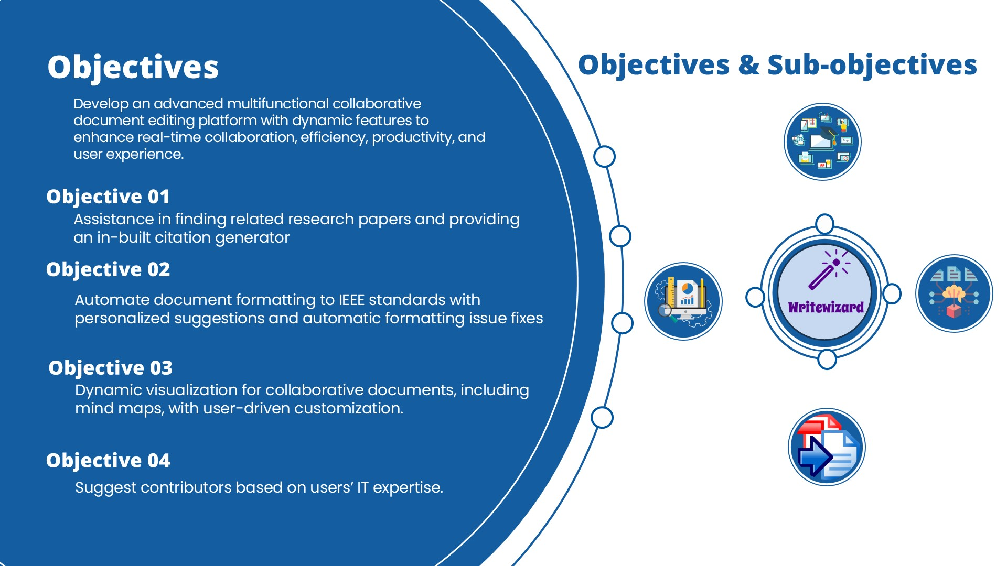
19/03/2025
Notes:
The main objective of our research is to obtain a dynamic, multifunctional collaborative document editing tool to improve the research author's use experience in writing Research papers.

Slide 8
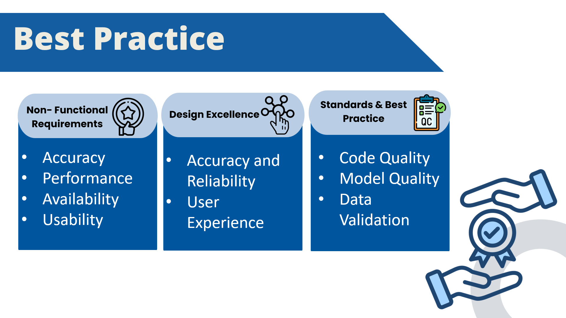

Slide 9
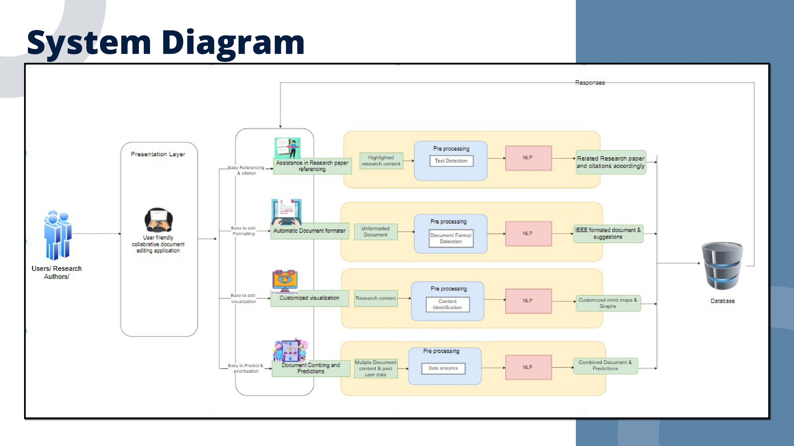
19/03/2025

Slide 10
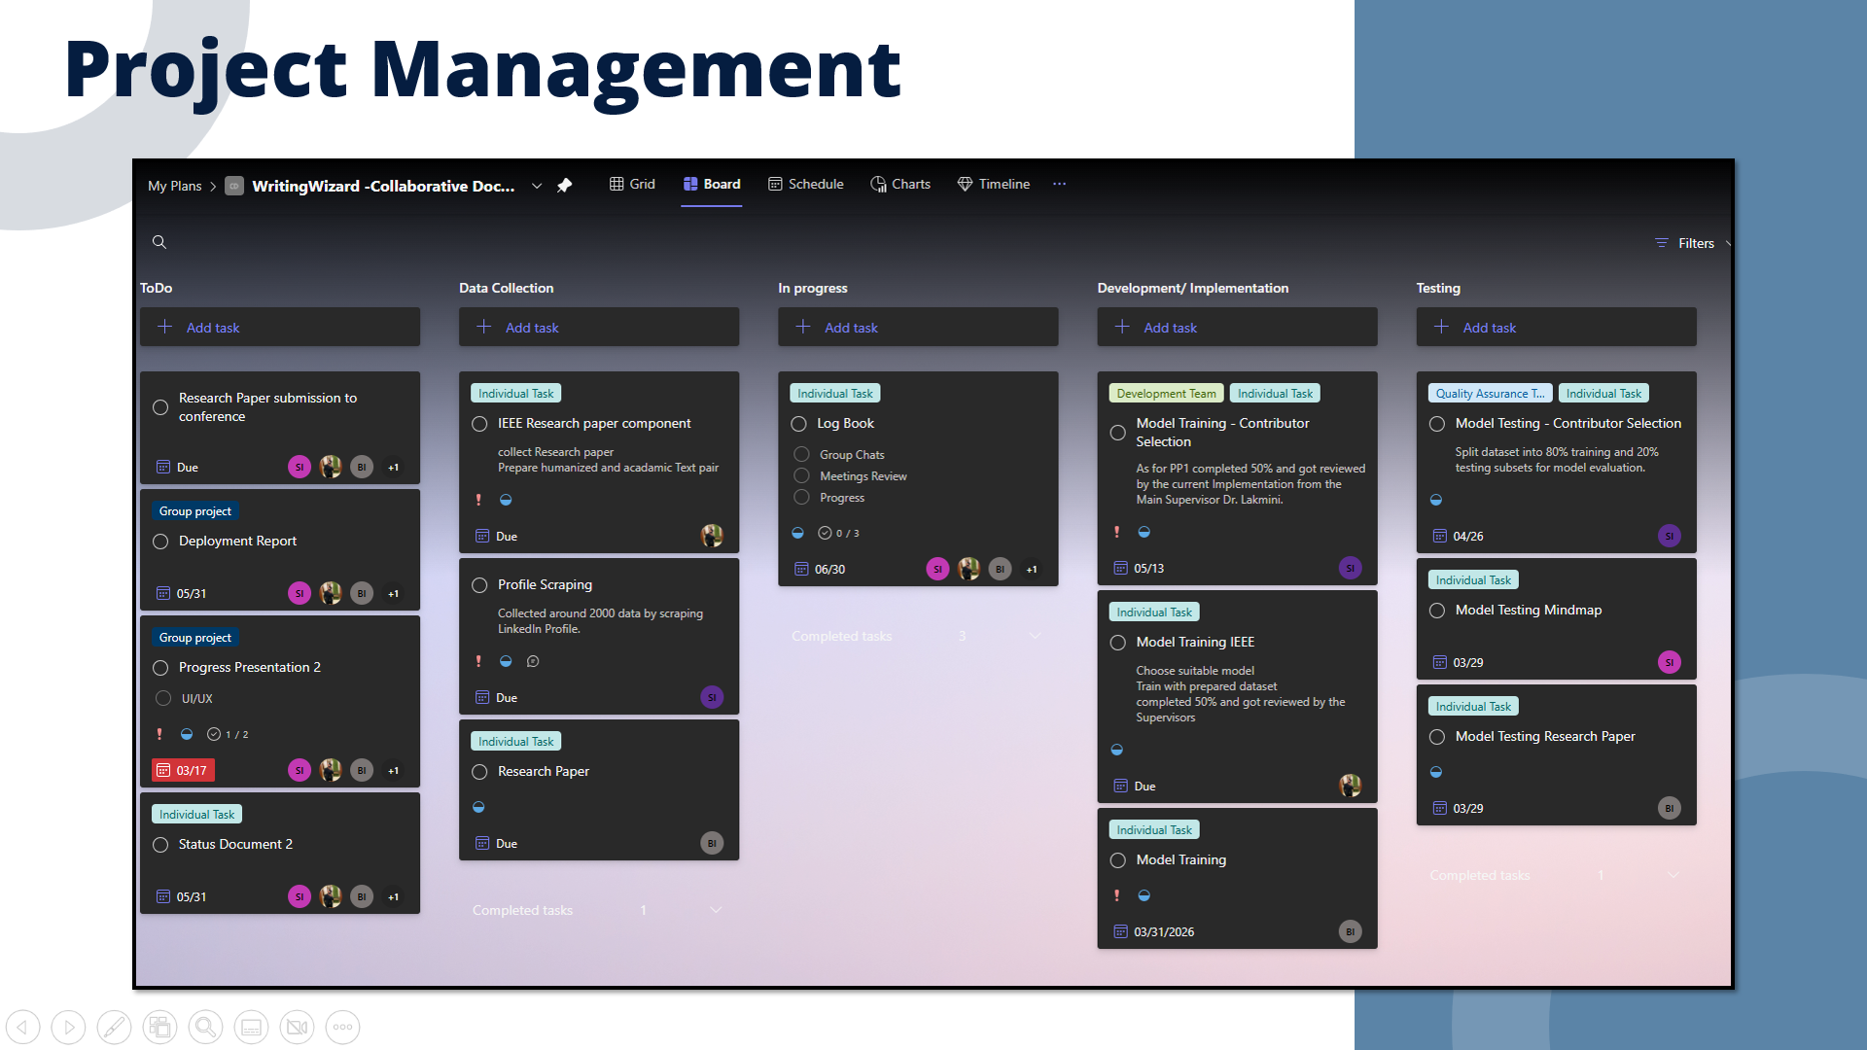
19/03/2025

Slide 11
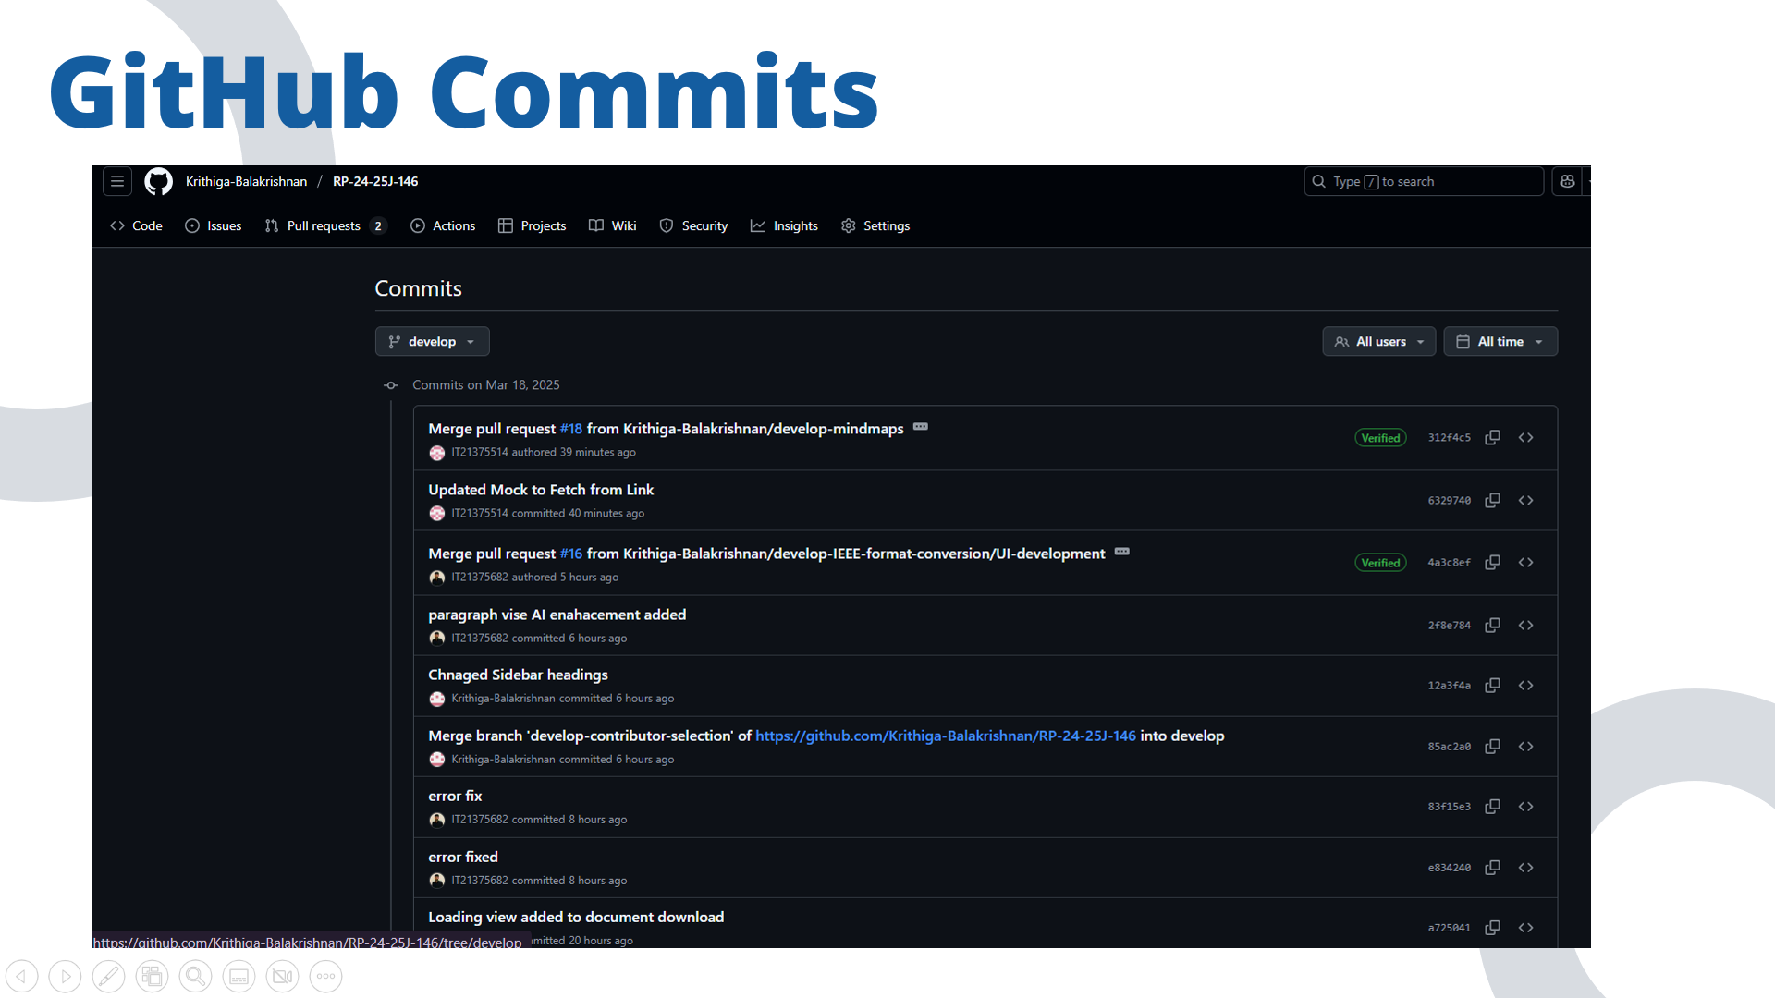
19/03/2025

Slide 12
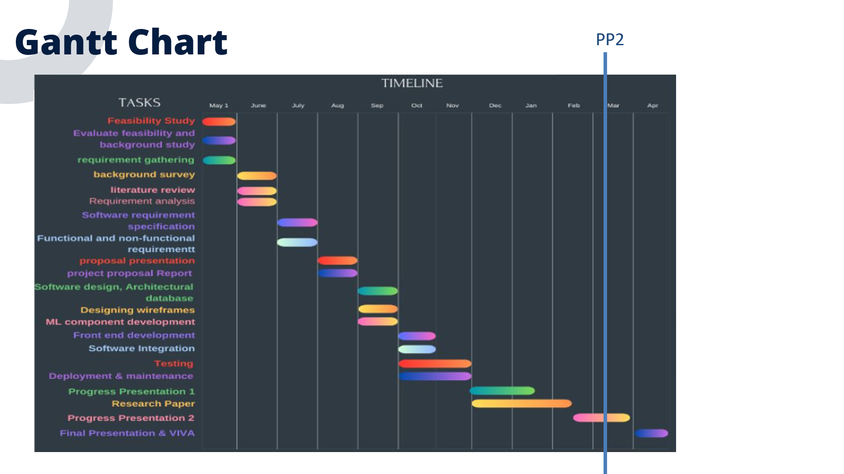
19/03/2025

Slide 13
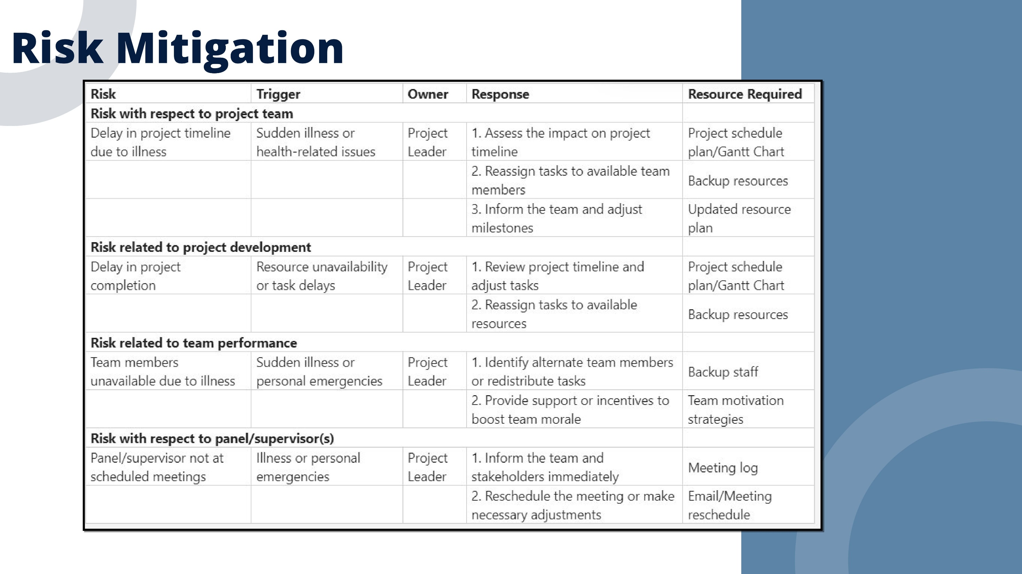
19/03/2025

Slide 14

19/03/2025
Notes:
We have developed this application from scratch, using Quil Js, JavaScript & Express. The Collborative will be demonstrated in the demonstration section.

Slide 15

IT21361036 | Saara M.K.F | 24-25J-146
19/03/2025

Slide 16

IT21361036 | Saara M.K.F | 24-25J-146
19/03/2025

Slide 17
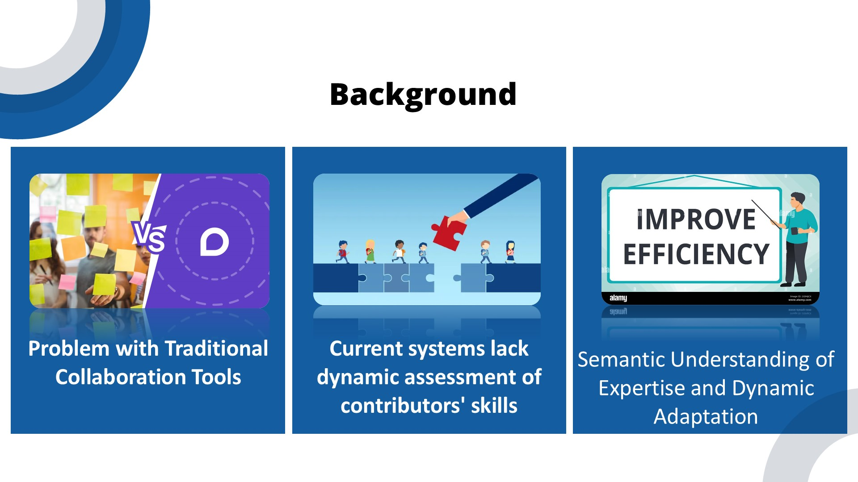
IT21361036 | Saara M.K.F | 24-25J-146
19/03/2025

Slide 18
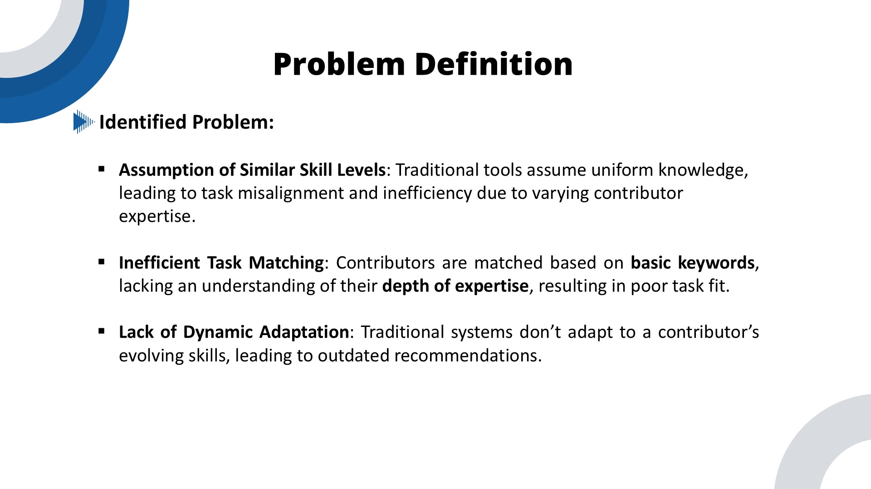
IT21361036 | Saara M.K.F | 24-25J-146
19/03/2025

Slide 19
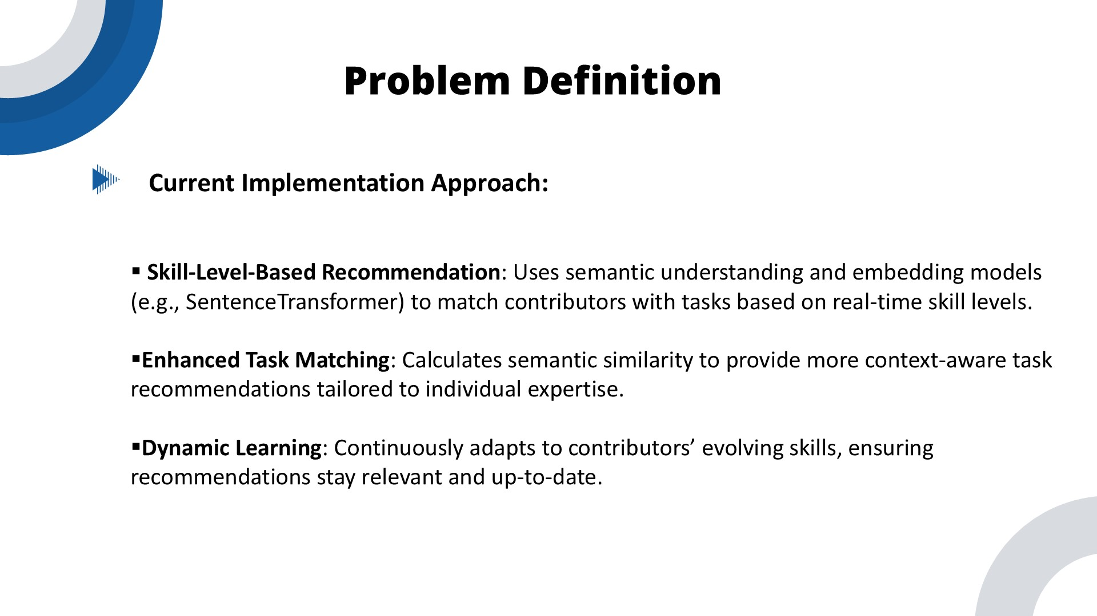
IT21361036 | Saara M.K.F | 24-25J-146
19/03/2025

Slide 20
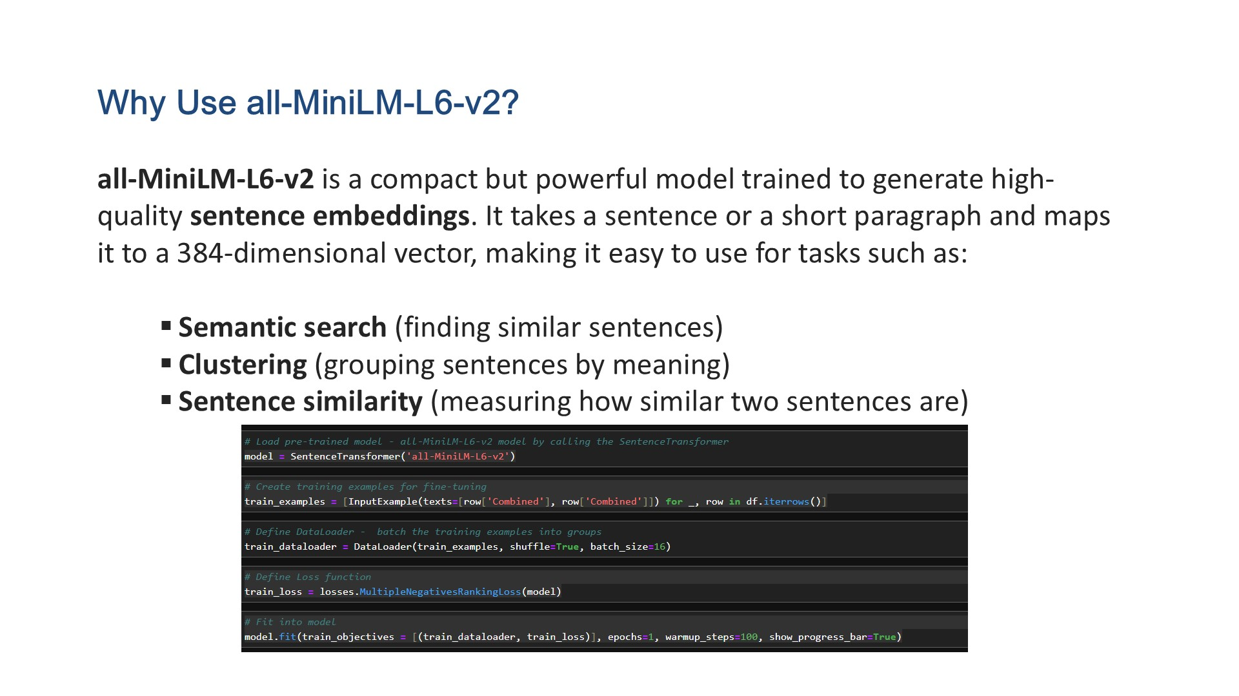
IT21361036 | Saara M.K.F | 24-25J-146
19/03/2025

Slide 21
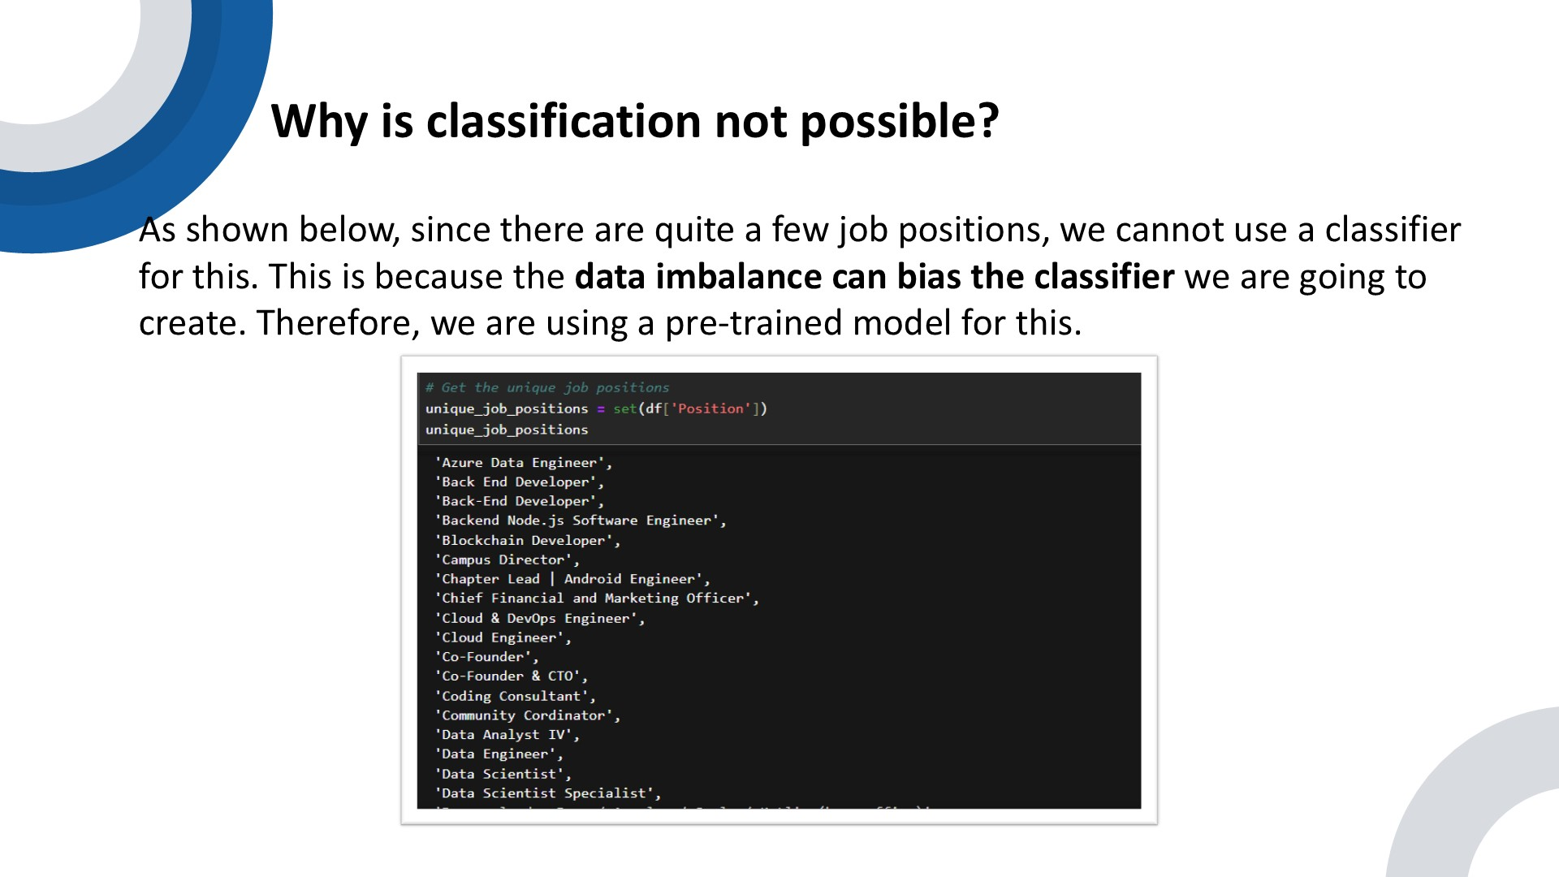
IT21361036 | Saara M.K.F | 24-25J-146
19/03/2025

Slide 22
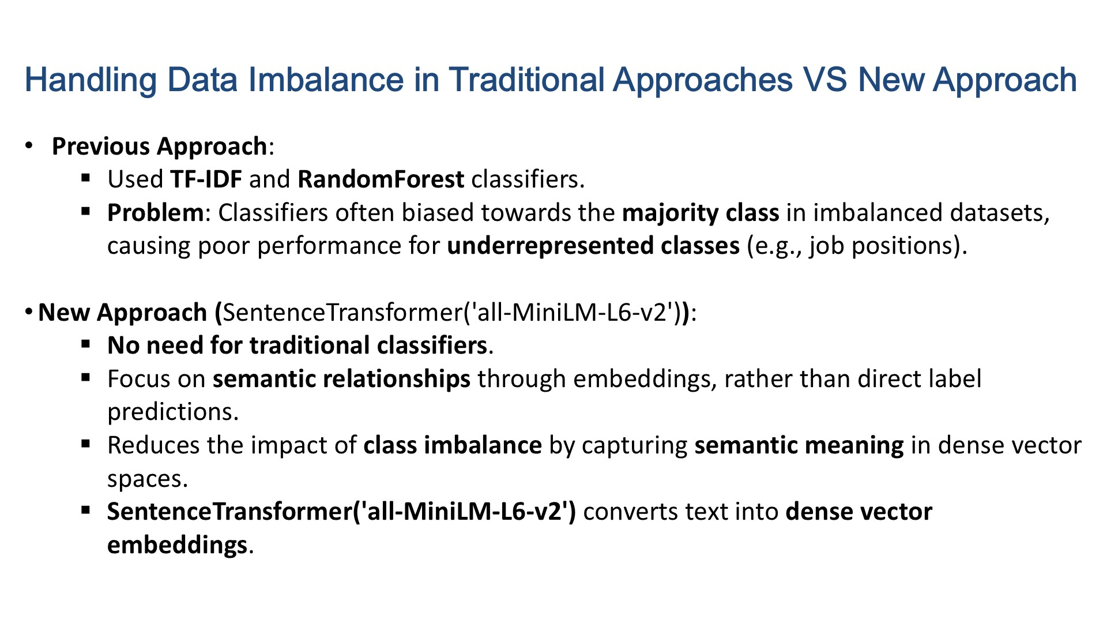
IT21361036 | Saara M.K.F | 24-25J-146
19/03/2025

Slide 23

IT21361036 | Saara M.K.F | 24-25J-146
19/03/2025

Slide 24
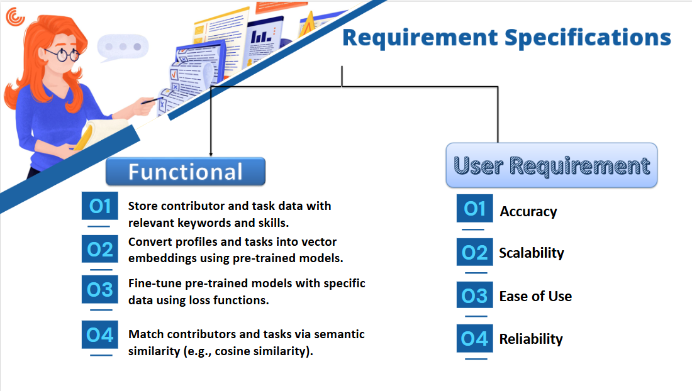
IT21361036 | Saara M.K.F | 24-25J-146
19/03/2025

Slide 25
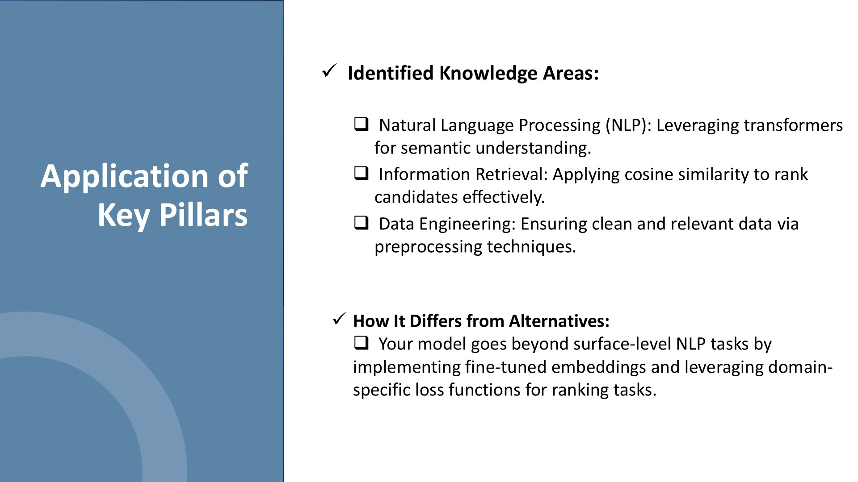
IT21361036 | Saara M.K.F | 24-25J-146
19/03/2025

Slide 26
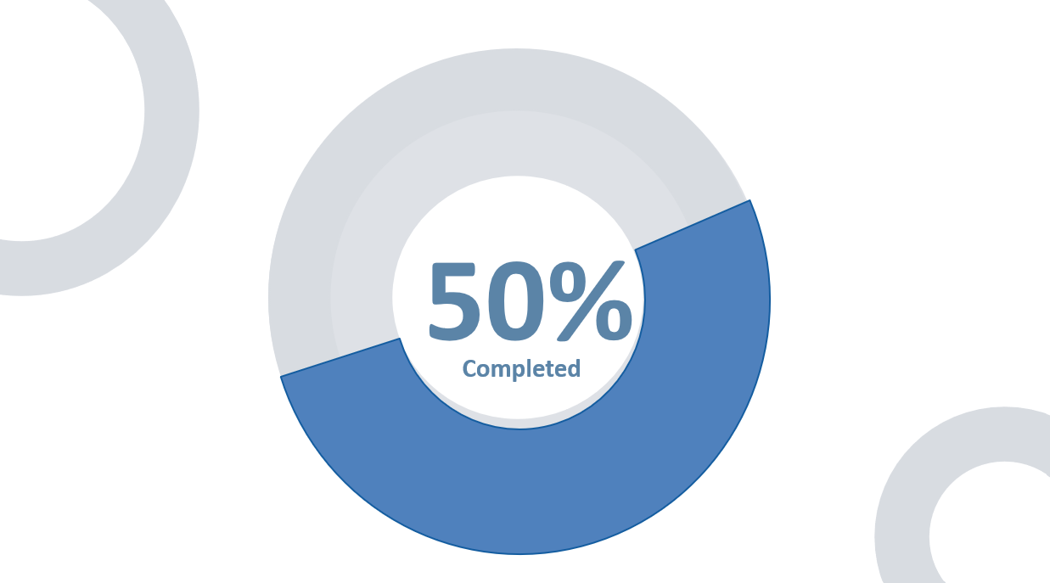
IT21361036 | Saara M.K.F | 24-25J-146
19/03/2025

Slide 27
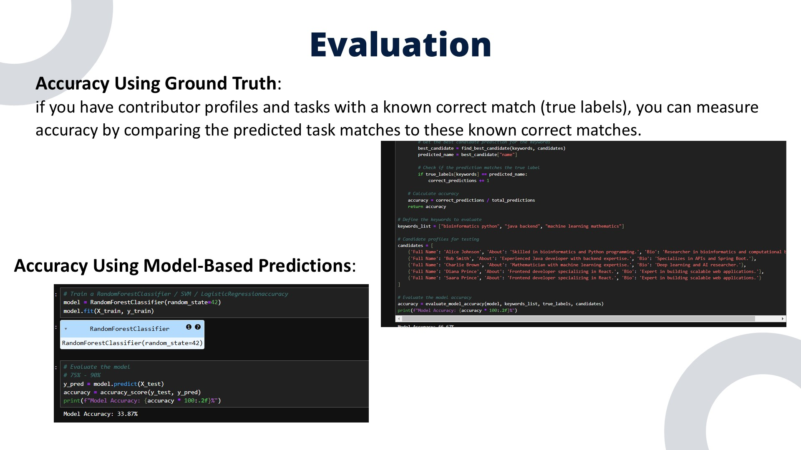
IT21361036 | Saara M.K.F | 24-25J-146
19/03/2025

Slide 28
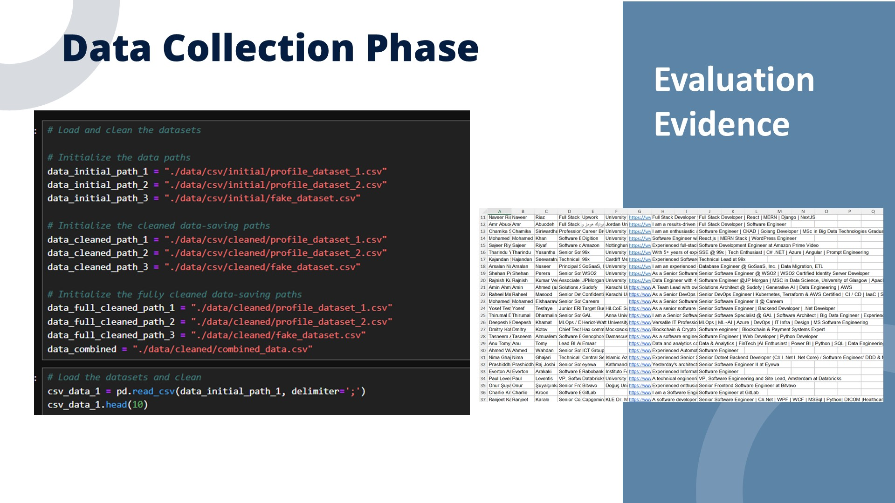
IT21361036 | Saara M.K.F | 24-25J-146
19/03/2025

Slide 29
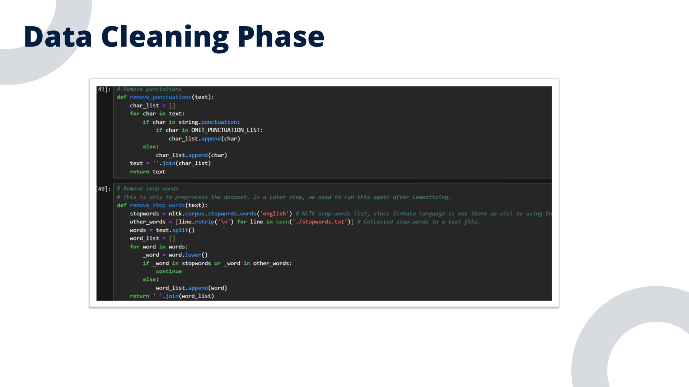
IT21361036 | Saara M.K.F | 24-25J-146
19/03/2025

Slide 30
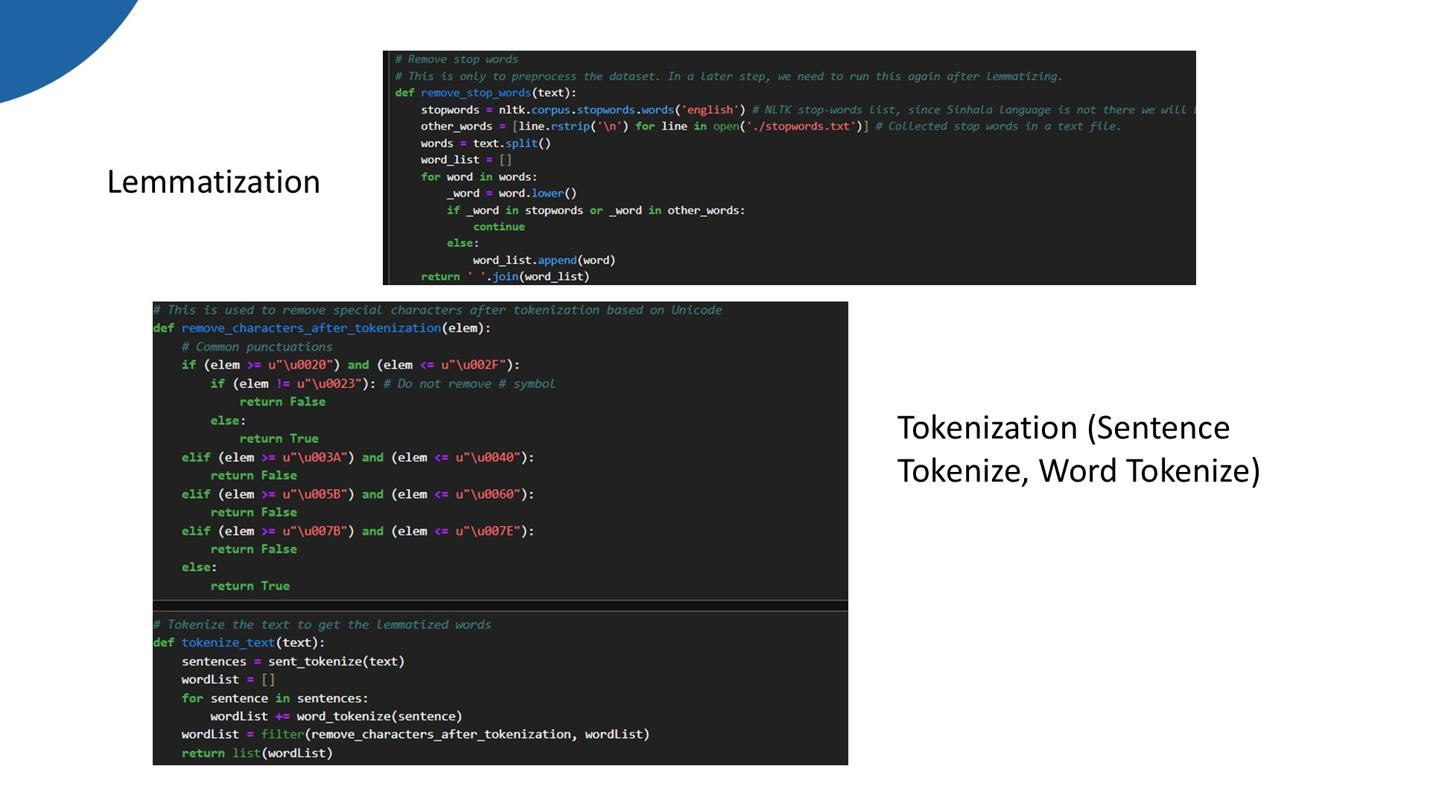
IT21361036 | Saara M.K.F | 24-25J-146
19/03/2025

Slide 31
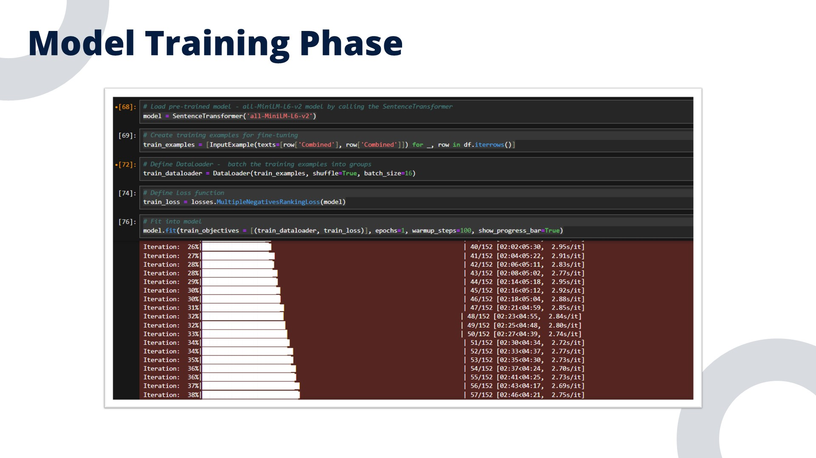
IT21361036 | Saara M.K.F | 24-25J-146
19/03/2025

Slide 32
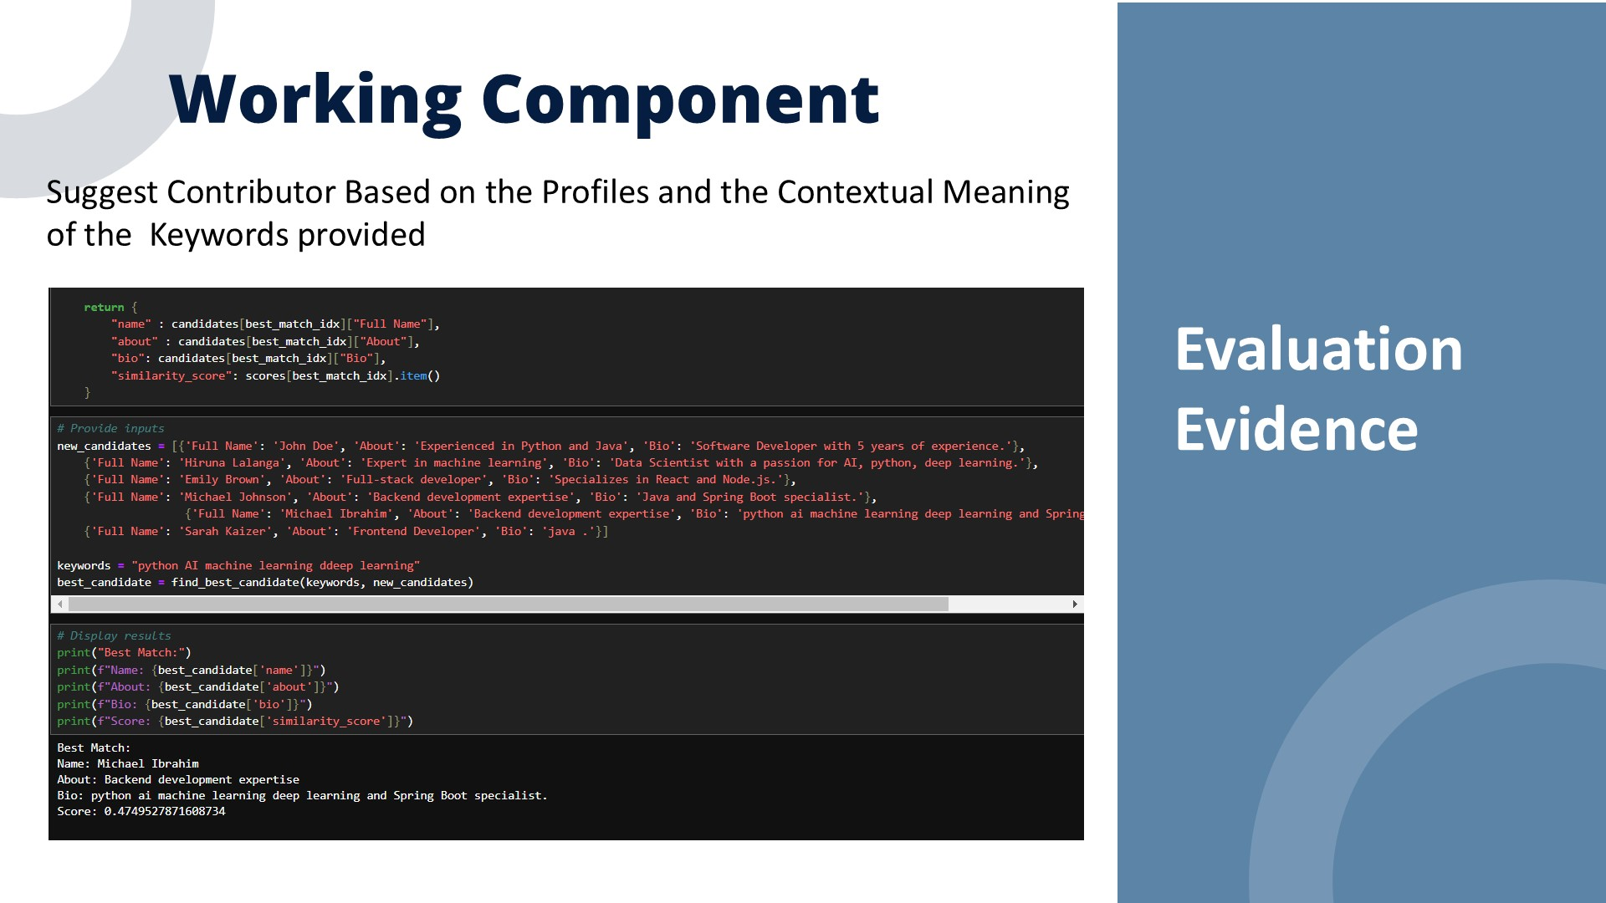
IT21361036 | Saara M.K.F | 24-25J-146
19/03/2025

Slide 33
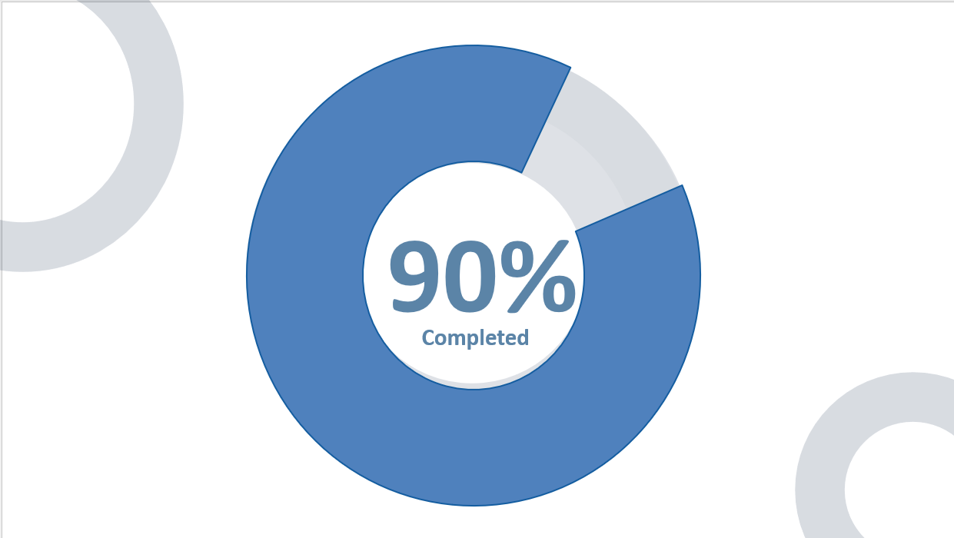
IT21361036 | Saara M.K.F | 24-25J-146
19/03/2025

Slide 34
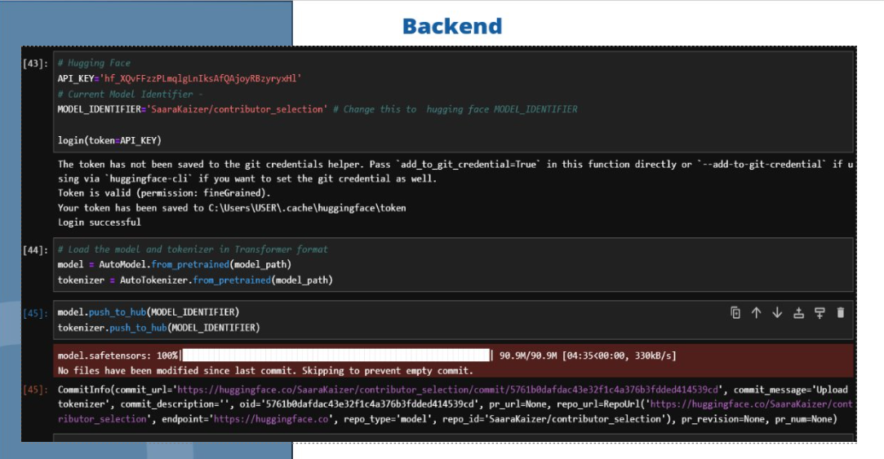
IT21361036 | Saara M.K.F | 24-25J-146
19/03/2025

Slide 35
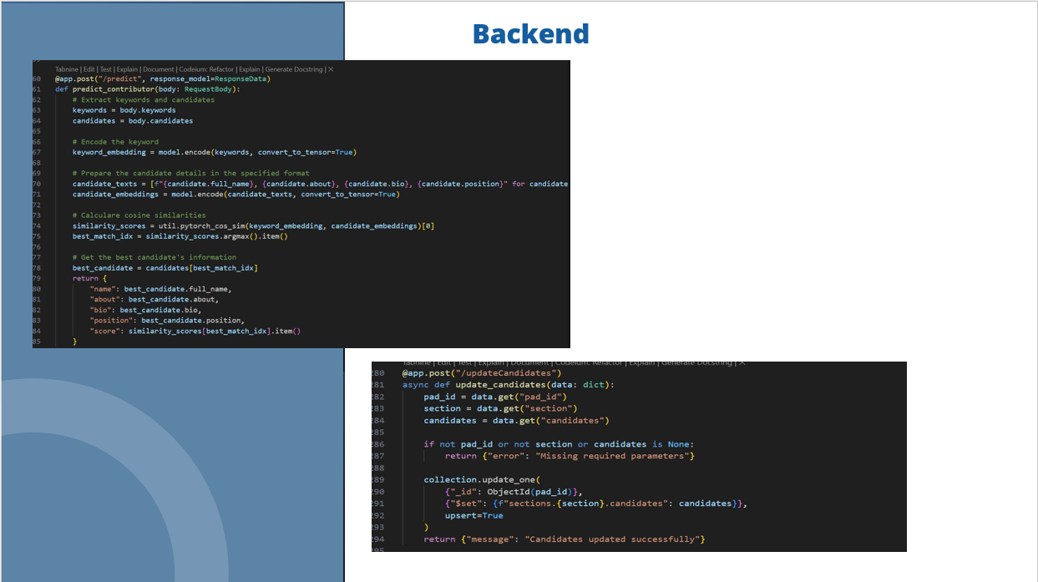
IT21361036 | Saara M.K.F | 24-25J-146
19/03/2025

Slide 36
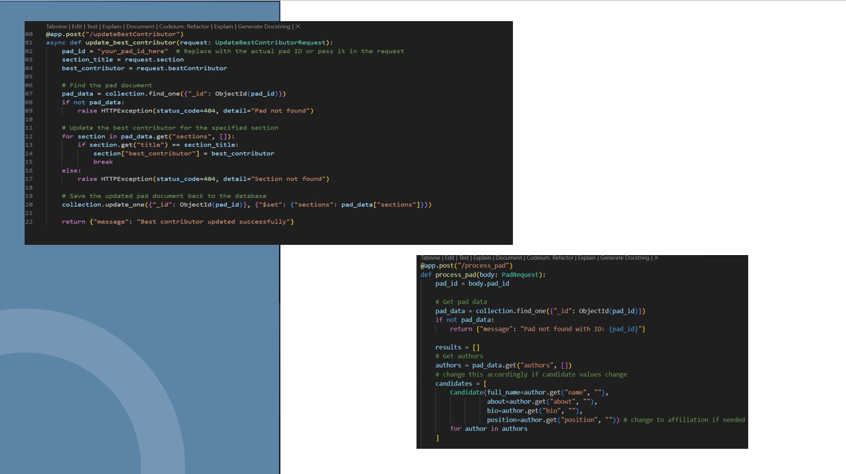
IT21361036 | Saara M.K.F | 24-25J-146
19/03/2025

Slide 37
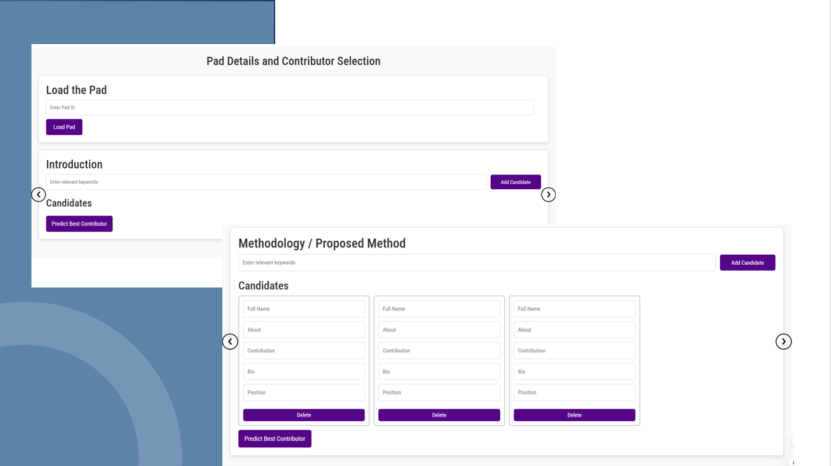
IT21361036 | Saara M.K.F | 24-25J-146
19/03/2025

Slide 38
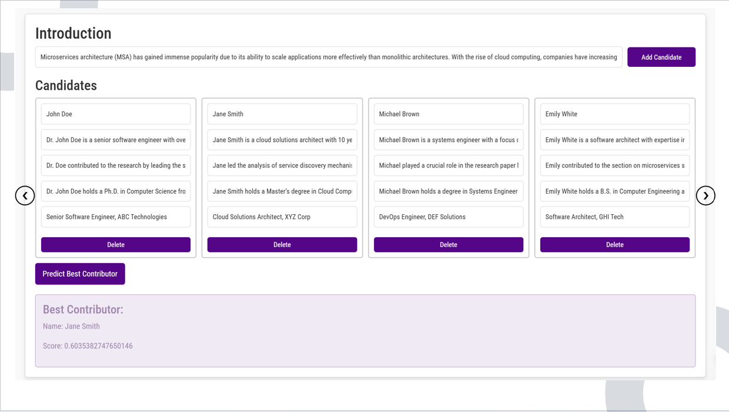
IT21361036 | Saara M.K.F | 24-25J-146
19/03/2025

Slide 39
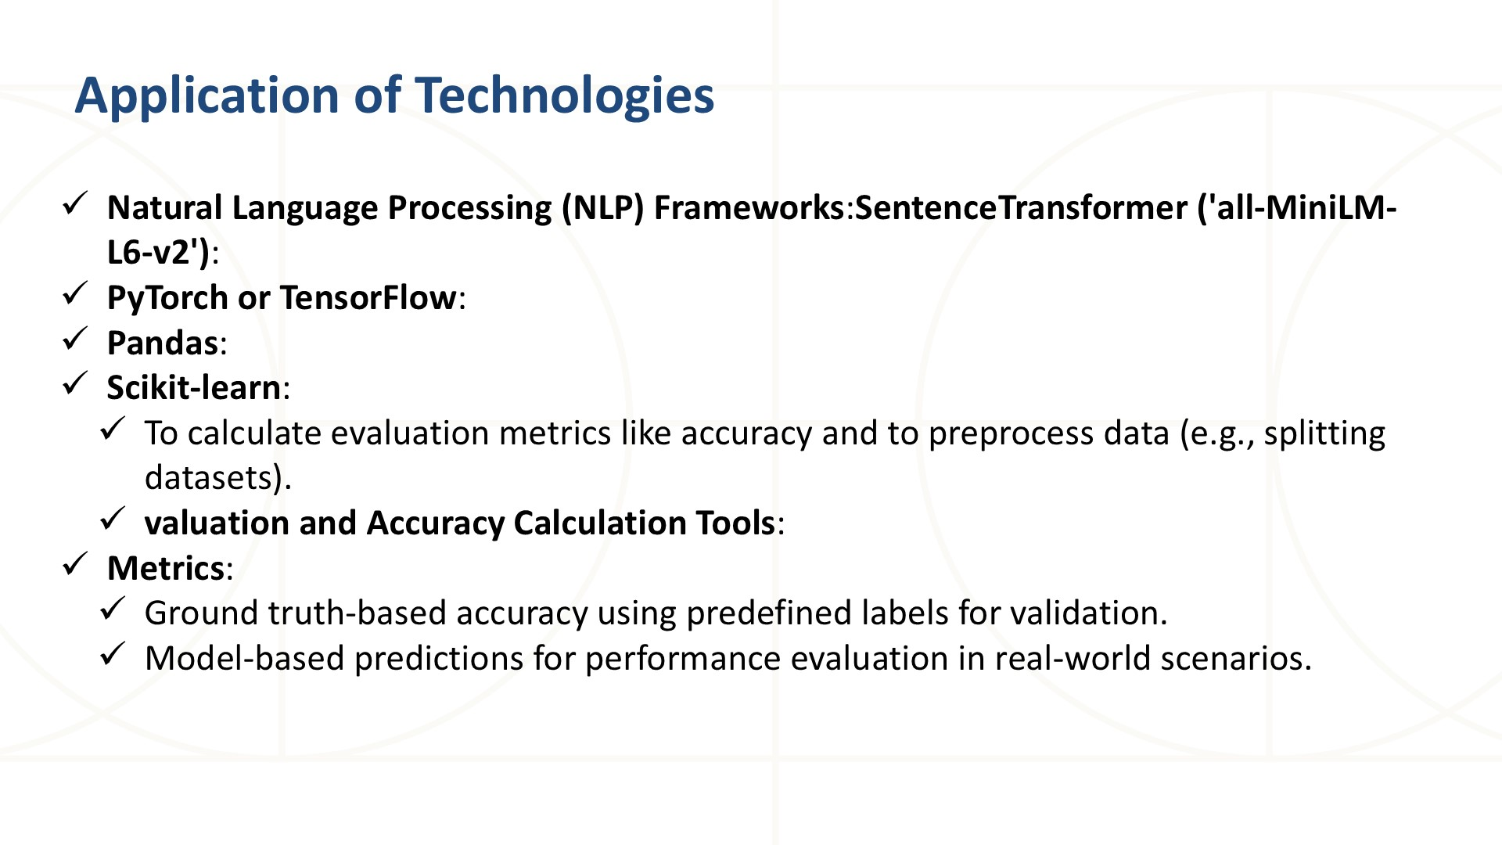
IT21361036 | Saara M.K.F | 24-25J-146
19/03/2025

Slide 40
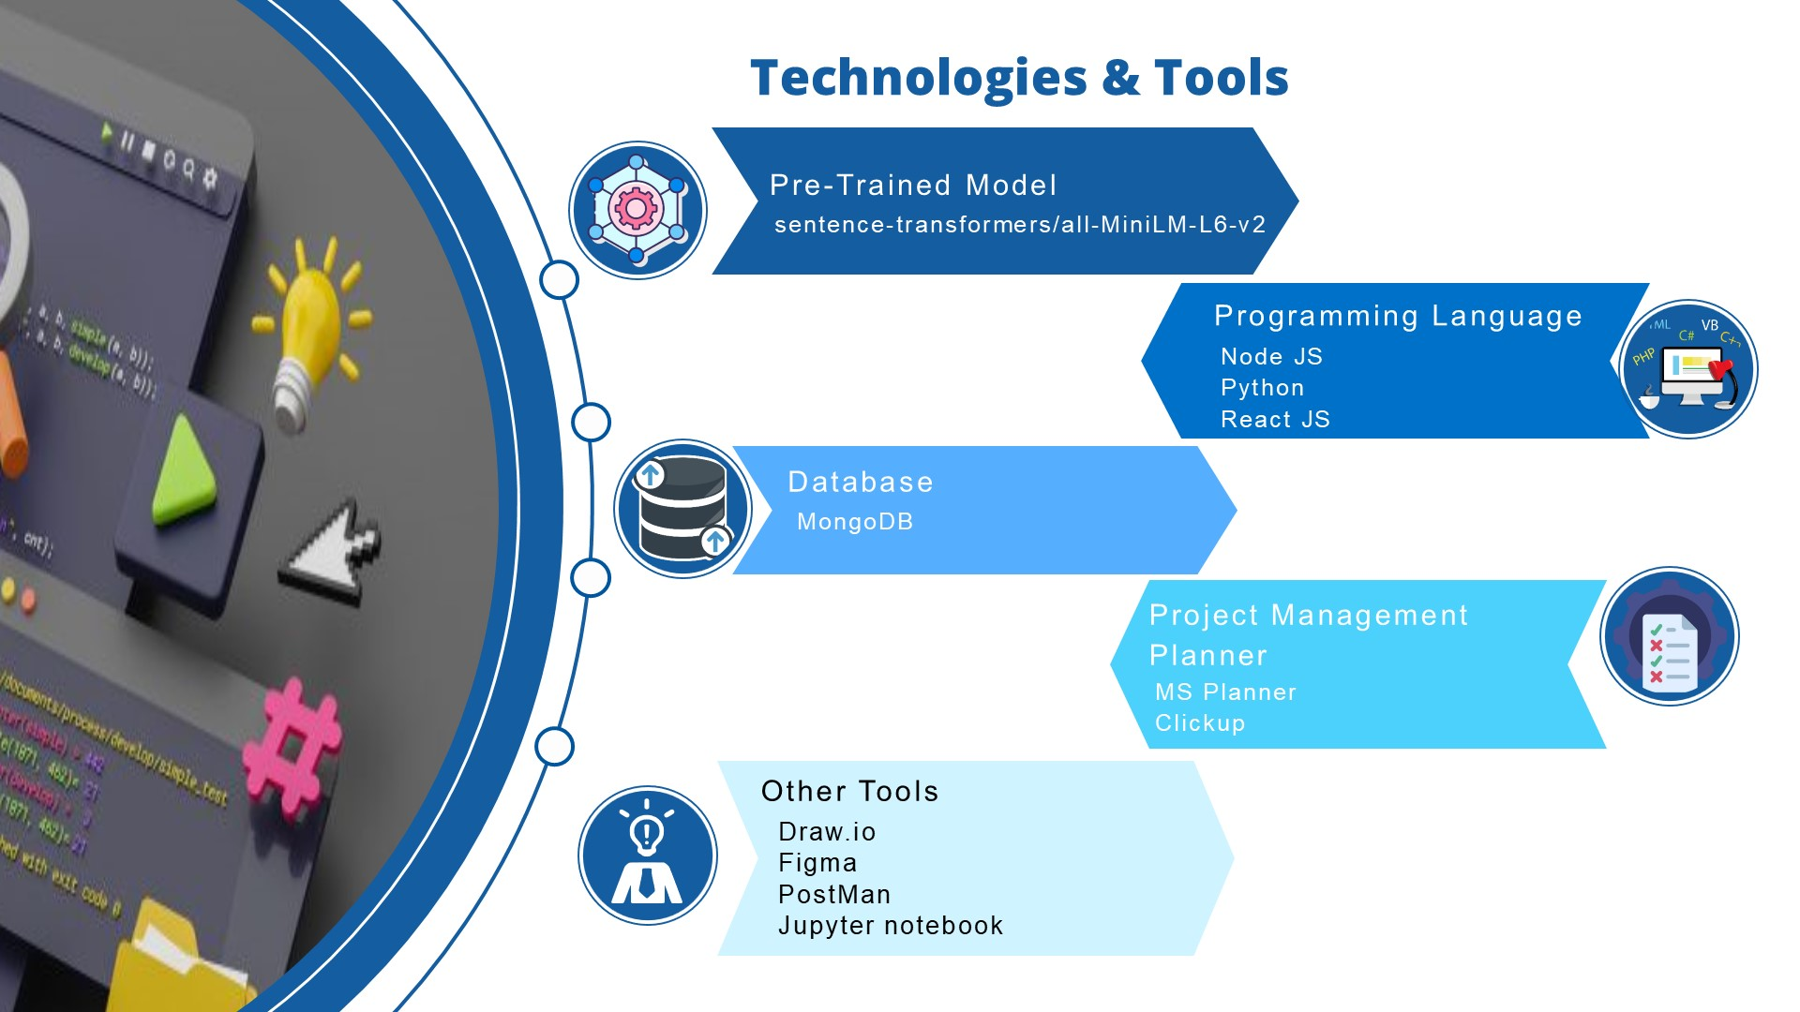
IT21361036 | Saara M.K.F | 24-25J-146
19/03/2025

Slide 41
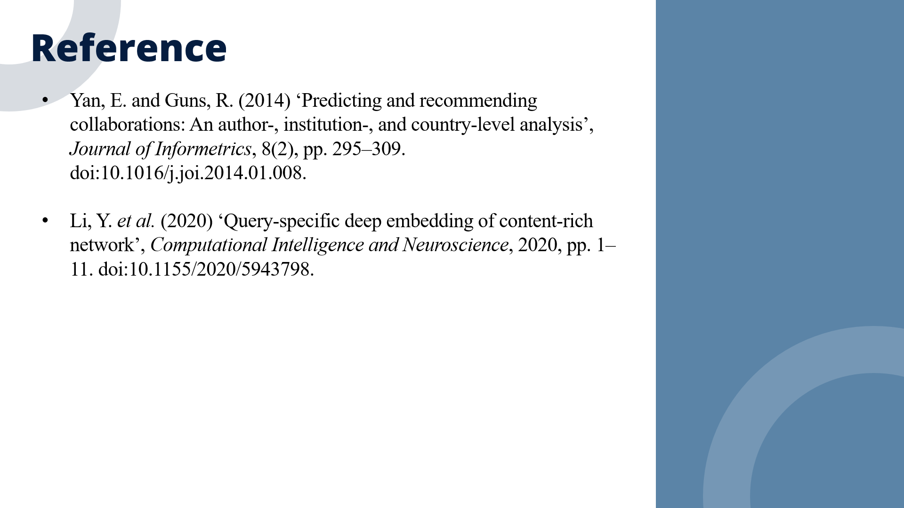
IT21361036 | Saara M.K.F | 24-25J-146
19/03/2025

Slide 42
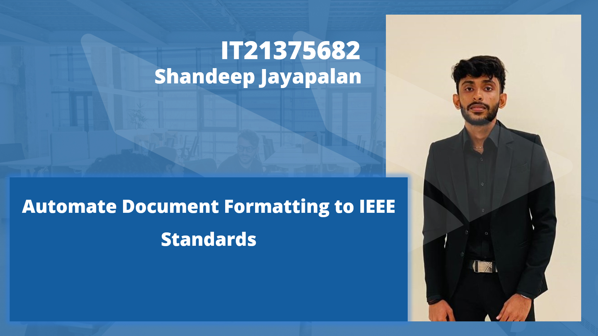
IT21375682 | Shandeep. J | 24-25J-146
19/03/2025

Slide 43
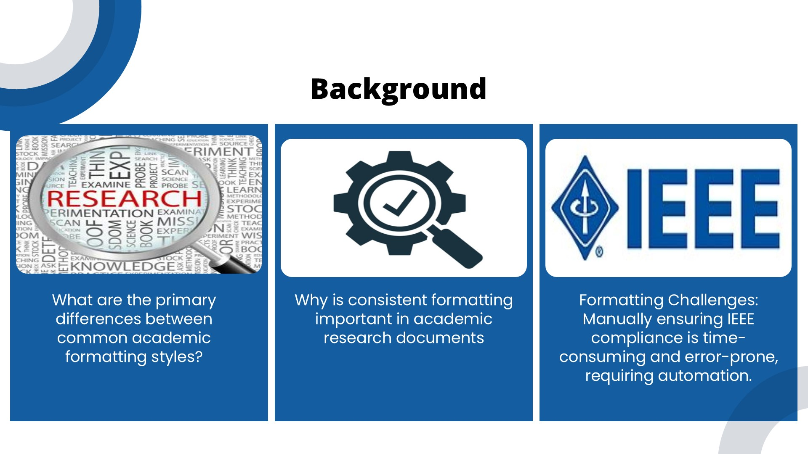
IT21375682 | Shandeep. J | 24-25J-146
19/03/2025
Notes:
There are various research standard for publish research paper. Quality of the research paper is also depends on the Language and document formating

Slide 44
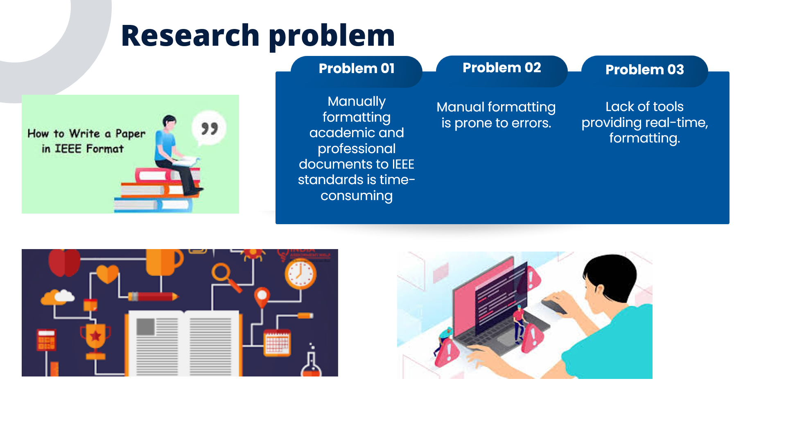
IT21375682 | Shandeep. J | 24-25J-146
19/03/2025
Notes:
Research formatting is complicated and time consuming tastk, when formatting we have to consider the language whether its in formal, passive voice, grammar, third person view and also the document formatting ,Like the proper two colum based structure ,fonts, font sizes ,standard method to author reference etc
There are lack of tools to give a complete formatted document without manual effort

Slide 45
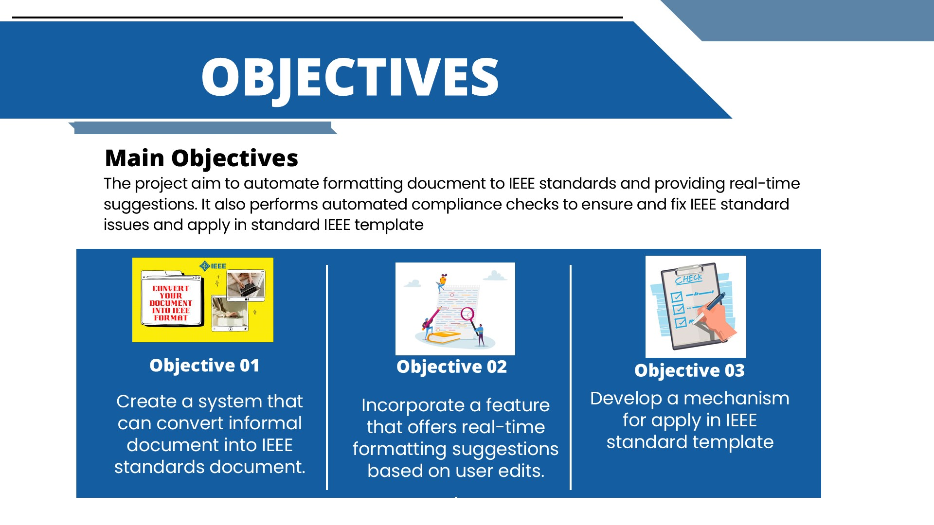
IT21375682 | Shandeep. J | 24-25J-146
19/03/2025
Notes:
When we do this manually its error prone and time consuming.
my main objective is to make author to idealize and write research content and the tool handle other formatting tasks.

Slide 46
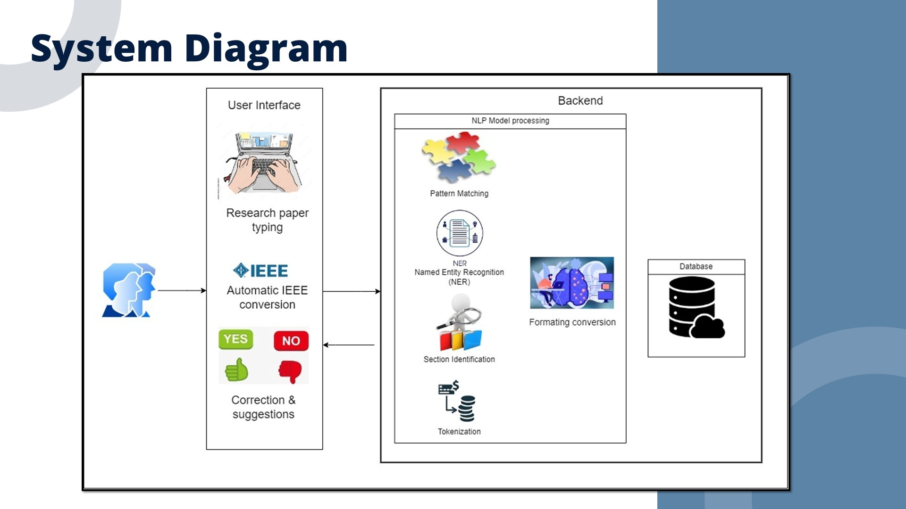
IT21375682 | Shandeep. J | 24-25J-146
19/03/2025
Notes:
For Format a research I had to focus on Research content and document structring aswell

Slide 47
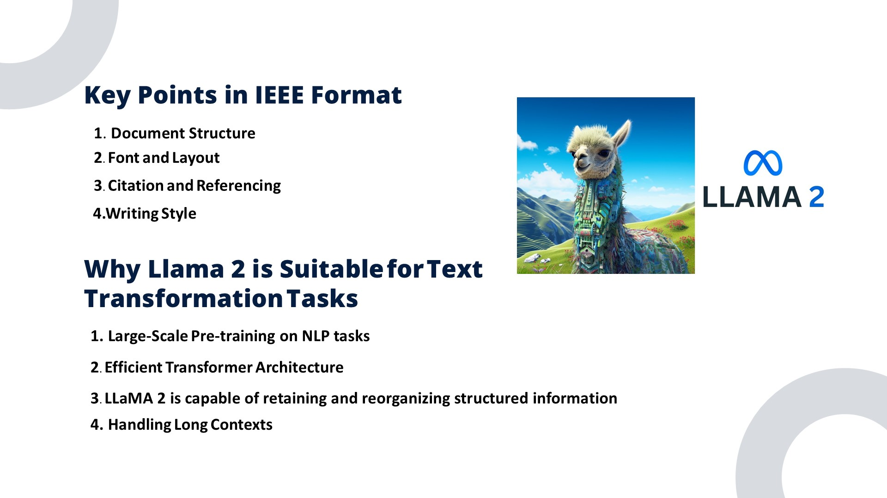
IT21375682 | Shandeep. J | 24-25J-146
19/03/2025
Notes:
For the academic text conversion, we’ve fine‑tuned the Llama2‑7B model. Our training data included informal, humanized text as well as formal IEEE academic writing. We crafted specific prompts that guide the model to convert a given section’s plain text into a version that meets IEEE standards. This conversion process helps users get a polished output even if they initially write in a more conversational tone

Slide 48
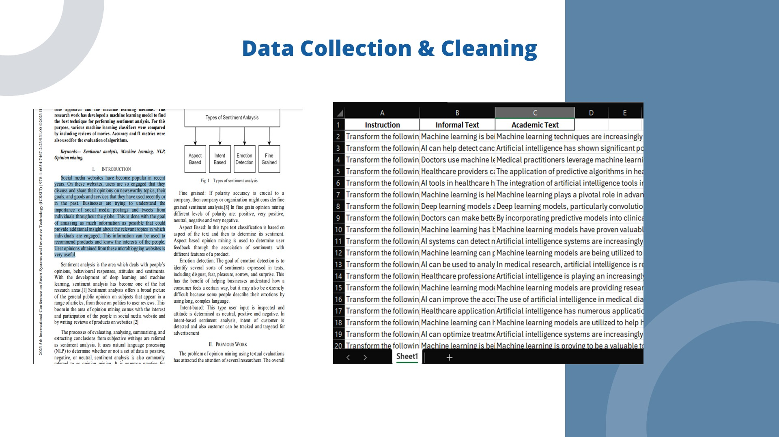
IT21375682 | Shandeep. J | 24-25J-146
19/03/2025

Slide 49
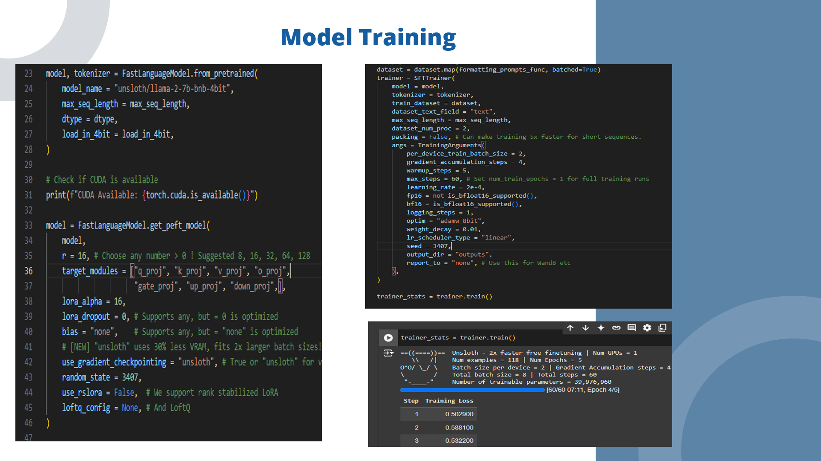
IT21375682 | Shandeep. J | 24-25J-146
19/03/2025

Slide 50
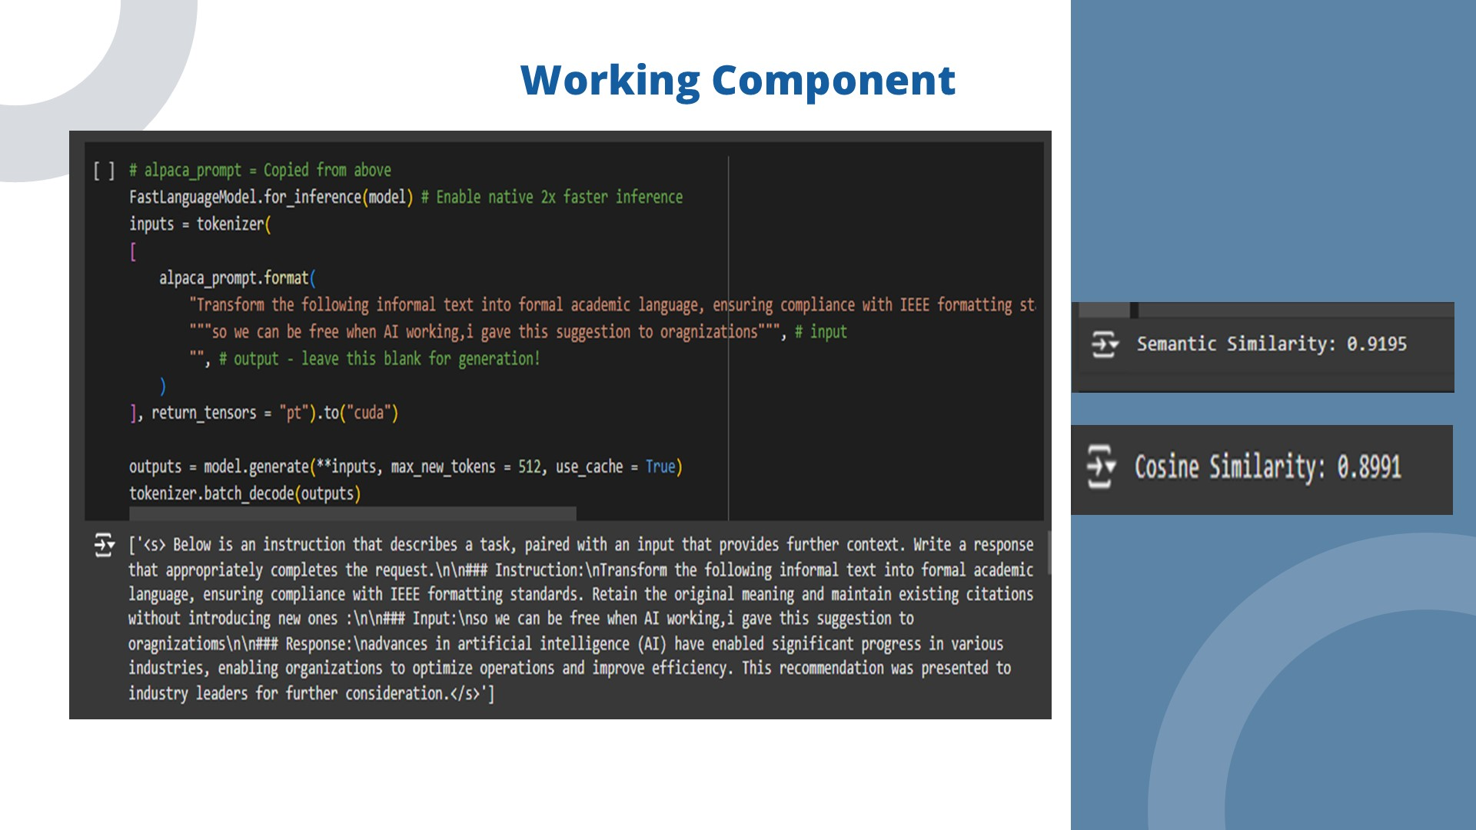
IT21375682 | Shandeep. J | 24-25J-146
19/03/2025

Slide 51
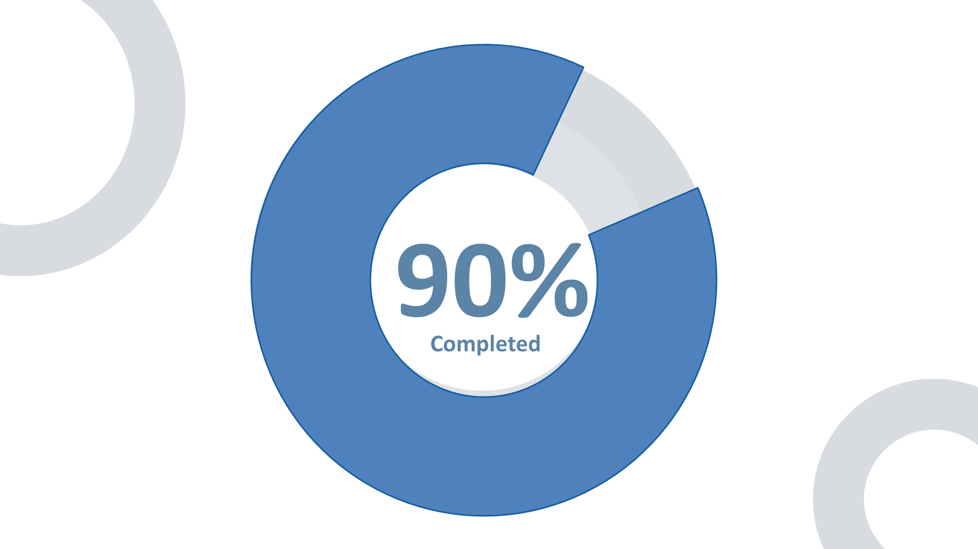
IT21375514 | Sanjayan. C | 24-25J-146
19/03/2025

Slide 52
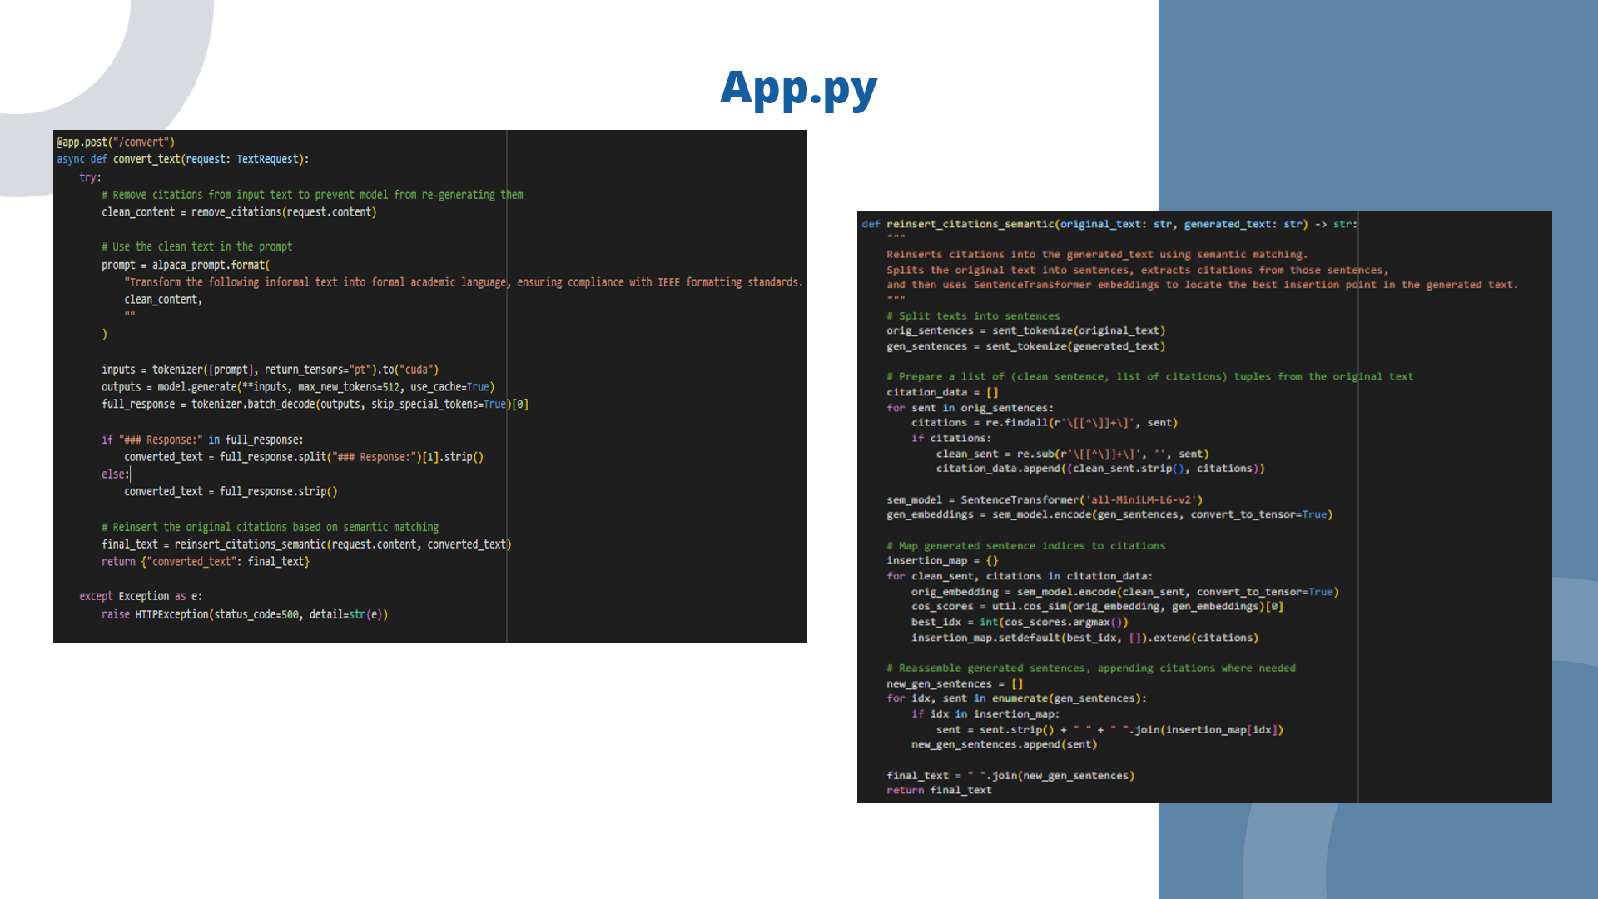
IT21375514 | Sanjayan. C | 24-25J-146
19/03/2025

Slide 53
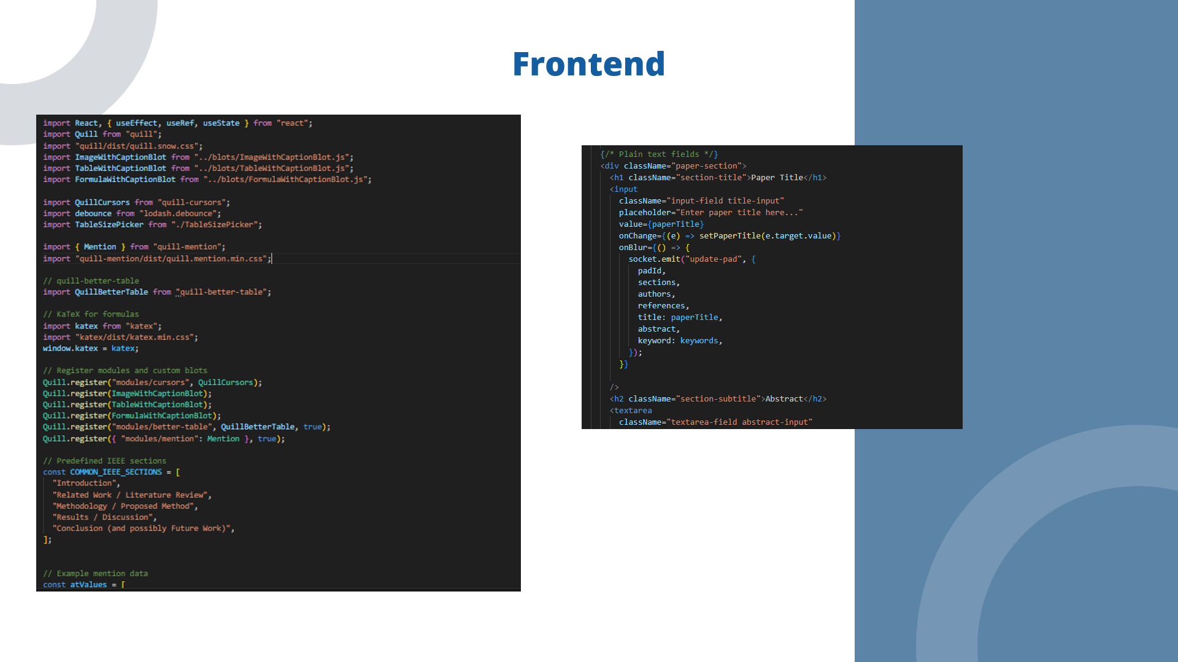
IT21375514 | Sanjayan. C | 24-25J-146
19/03/2025
Notes:
Our system uses a front‑end rich text editor powered by Quill. As users work on their documents, they embed not only plain text but also specialized content like images with captions, formulas with captions, and tables with captions. Each of these embeds is stored in our backend as part of a Delta object, a structured JSON format representing the entire document.

Slide 54
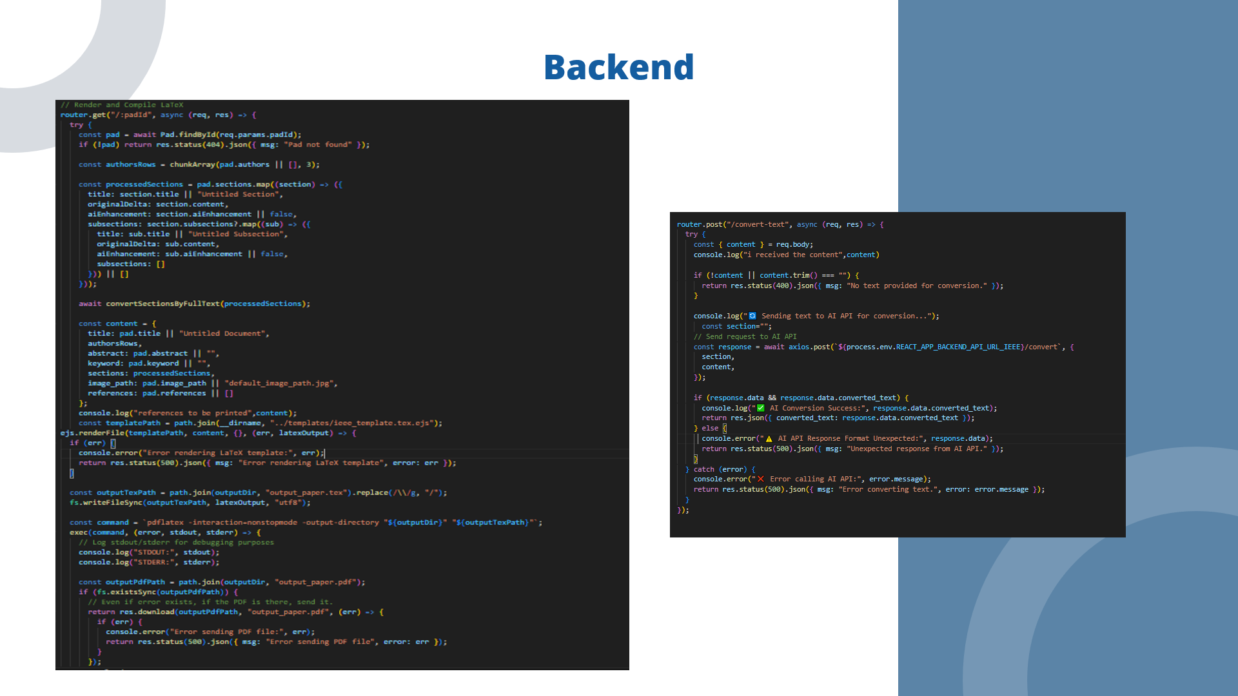
IT21375514 | Sanjayan. C | 24-25J-146
19/03/2025
Notes:
On the backend, our IEEE route is responsible for transforming this Delta into LaTeX. In our code, the convertDeltaToLatex function iterates over the Delta’s operations sequentially. which users entered their content—ensuring that text, images, formulas, and tables appear in the final document exactly as they were originally created.

Slide 55

IT21375514 | Sanjayan. C | 24-25J-146
19/03/2025

Slide 56

IT21375514 | Sanjayan. C | 24-25J-146
19/03/2025

Slide 57

IT21375514 | Sanjayan. C | 24-25J-146
19/03/2025

Slide 58

IT21375682 | Shandeep. J | 24-25J-146
19/03/2025

Slide 59

IT21375682 | Shandeep. J | 24-25J-146
19/03/2025

Slide 60

IT21375682 | Shandeep. J | 24-25J-146
19/03/2025

Slide 61

IT21375682 | Shandeep. J | 24-25J-146
19/03/2025

Slide 62

IT21375682 | Shandeep. J | 24-25J-146
19/03/2025

Slide 63

IT21375514 | Sanjayan. C | 24-25J-146
19/03/2025

Slide 64

IT21375682 | Shandeep. J | 24-25J-146
19/03/2025

Slide 65

IT21375682 | Shandeep. J | 24-25J-146
19/03/2025

Slide 66

IT21375514 | Sanjayan. C | 24-25J-146
19/03/2025

Slide 67
IT21375514 | Sanjayan. C | 24-25J-146
19/03/2025

Slide 68

IT21375514 | Sanjayan. C | 24-25J-146
19/03/2025
Notes:
Good afternoon, everyone. I’m Sanjayan, and today I’m here to present the final update on my project component: Mind Map Visualization for Collaborative Documents.

Slide 69

IT21375514 | Sanjayan. C | 24-25J-146
19/03/2025
Notes:
In the earlier work, I discovered that current implementations faced significant challenges: they generated limited mind maps, offered few customization options, and struggled with clearly visualizing the connections between concepts.

Slide 70


IT21375514 | Sanjayan. C | 24-25J-146
19/03/2025
Notes:
To solve these challenges, I created a proof-of-concept that uses a fine-tuned NLP model to convert text content into structured JSON mind maps, which are then rendered interactively.

Slide 71

IT21375514 | Sanjayan. C | 24-25J-146
19/03/2025
Notes:
The method automates the creation of hierarchical mind maps by training the Mistral-7B-v0.3 model on pairs of raw text and manually built JSON maps that clearly show parent–child relationships. I use light preprocessing like splitting sentences, special character removal and tokenizing text.

Slide 72

IT21375514 | Sanjayan. C | 24-25J-146
19/03/2025

Slide 73
IT21375514 | Sanjayan. C | 24-25J-146
19/03/2025

Slide 74

IT21375514 | Sanjayan. C | 24-25J-146
19/03/2025
Notes:
Our fine-tuned model is now hosted in a Colab environment using FastAPI and embedded within a web application built on the MERN framework

Slide 75

IT21375514 | Sanjayan. C | 24-25J-146
19/03/2025
Notes:
Additionally, I have finetuned the model to get the extended and simplified versions of the mind map and I have integrated an image suggestion mechanism, where relevant images are automatically proposed for key nodes further enriching the visual context.

Slide 76

IT21375514 | Sanjayan. C | 24-25J-146
19/03/2025
Notes:
The web application uses D3.js for interactive visualization and customization, transforming my prototype into fully functional units ready for easy use for any users.

Slide 77

IT21375514 | Sanjayan. C | 24-25J-146
19/03/2025
Notes:
It will check for the best matching node with the images that are in the document and add it within the nodes.

Slide 78

IT21375514 | Sanjayan. C | 24-25J-146
19/03/2025
Notes:
I focused on minimalist design and by incorporating iterative user feedback and industry best practices, we have achieved a design that is not only visually appealing but also highly usable.

Slide 79

IT21375514 | Sanjayan. C | 24-25J-146
19/03/2025

Slide 80

IT21375514 | Sanjayan. C | 24-25J-146
19/03/2025

Slide 81

IT21375514 | Sanjayan. C | 24-25J-146
19/03/2025
Notes:
My system meets high standards for performance, scalability, usability, reliability, and accessibility. Real-time updates and smooth interactions are key nonfunctional requirements. But due to the token limitations and High resource needs for now we had to strict into the boundary.
With these advancements, this is not only a technical success but also holds significant commercial potential. It can be integrated to any applications and let users to have a visual look which is more preferred by the users today.

Slide 82
IT21375514 | Sanjayan. C | 24-25J-146
19/03/2025
Notes:
Good afternoon, everyone. I’m Sanjayan, and today I’m here to present the final update on my project component: Mind Map Visualization for Collaborative Documents.

Slide 83
IT21375514 | Sanjayan. C | 24-25J-146
19/03/2025
Notes:
In the earlier work, I discovered that current implementations faced significant challenges: they generated limited mind maps, offered few customization options, and struggled with clearly visualizing the connections between concepts.

Slide 84

IT21375514 | Sanjayan. C | 24-25J-146
19/03/2025

Slide 85

IT21375514 | Sanjayan. C | 24-25J-146
19/03/2025

Slide 86

IT21375514 | Sanjayan. C | 24-25J-146
19/03/2025

Slide 87

IT21375514 | Sanjayan. C | 24-25J-146
19/03/2025

Slide 88

IT21375514 | Sanjayan. C | 24-25J-146
19/03/2025

Slide 89

IT21375514 | Sanjayan. C | 24-25J-146
19/03/2025

Slide 90
IT21375514 | Sanjayan. C | 24-25J-146
19/03/2025
Notes:
To solve these challenges, I created a proof-of-concept that uses a fine-tuned NLP model to convert text content into structured JSON mind maps, which are then rendered interactively.

Slide 91

IT21375514 | Sanjayan. C | 24-25J-146
19/03/2025

Slide 92
IT21375514 | Sanjayan. C | 24-25J-146
19/03/2025

Slide 93

IT21375514 | Sanjayan. C | 24-25J-146
19/03/2025

Slide 94
IT21375514 | Sanjayan. C | 24-25J-146
19/03/2025
Notes:
The method automates the creation of hierarchical mind maps by training the Mistral-7B-v0.3 model on pairs of raw text and manually built JSON maps that clearly show parent–child relationships. I use light preprocessing like splitting sentences and tokenizing text.

Slide 95
IT21375514 | Sanjayan. C | 24-25J-146
19/03/2025

Slide 96

IT21375514 | Sanjayan. C | 24-25J-146
19/03/2025

Slide 97

IT21375514 | Sanjayan. C | 24-25J-146
19/03/2025

Slide 98

IT21375514 | Sanjayan. C | 24-25J-146
19/03/2025

Slide 99

IT21375514 | Sanjayan. C | 24-25J-146
19/03/2025

Slide 100

IT21375514 | Sanjayan. C | 24-25J-146
19/03/2025

Slide 101

IT21375514 | Sanjayan. C | 24-25J-146
19/03/2025

Slide 102

IT21194894 | Krithiga. D. Balakrishnan | 24-25J-146
19/03/2025

Slide 103

IT21194894 | Krithiga. D. Balakrishnan | 24-25J-146
19/03/2025

Slide 104

IT21194894 | Krithiga. D. Balakrishnan | 24-25J-146
19/03/2025
Notes:
I have taken this research component into consideration because there are lack of tools that have collaborative inbuilt reference generator & Citation generator.

Slide 105

IT21194894 | Krithiga. D. Balakrishnan | 24-25J-146
19/03/2025
Notes:
The main problems we have focused while developing this component is to efficiently retrieve the semantic meaning of the

Slide 106

IT21194894 | Krithiga. D. Balakrishnan | 24-25J-146
19/03/2025

Slide 107

IT21194894 | Krithiga. D. Balakrishnan | 24-25J-146
19/03/2025

Slide 108

IT21194894 | Krithiga. D. Balakrishnan | 24-25J-146
19/03/2025

Slide 109

IT21194894 | Krithiga. D. Balakrishnan | 24-25J-146
19/03/2025

Slide 110

IT21194894 | Krithiga. D. Balakrishnan | 24-25J-146
19/03/2025

Slide 111

IT21194894 | Krithiga. D. Balakrishnan | 24-25J-146
19/03/2025

Slide 112


Slide 113

IT21194894 | Krithiga. D. Balakrishnan | 24-25J-146
19/03/2025

Slide 114

IT21194894 | Krithiga. D. Balakrishnan | 24-25J-146
19/03/2025

Slide 115

IT21194894 | Krithiga. D. Balakrishnan | 24-25J-146
19/03/2025

Slide 116

IT21194894 | Krithiga. D. Balakrishnan | 24-25J-146
19/03/2025

Slide 117

IT21194894 | Krithiga. D. Balakrishnan | 24-25J-146
19/03/2025

Slide 118

IT21194894 | Krithiga. D. Balakrishnan | 24-25J-146
19/03/2025

Slide 119

IT21194894 | Krithiga. D. Balakrishnan | 24-25J-146
19/03/2025

Slide 120

IT21194894 | Krithiga. D. Balakrishnan | 24-25J-146
19/03/2025

Slide 121


Slide 122


Slide 123


Slide 124


Slide 125


Slide 126


Slide 127


Slide 128

IT21194894 | Krithiga. D. Balakrishnan | 24-25J-146
19/03/2025

Slide 129

19/03/2025

